Slide 1
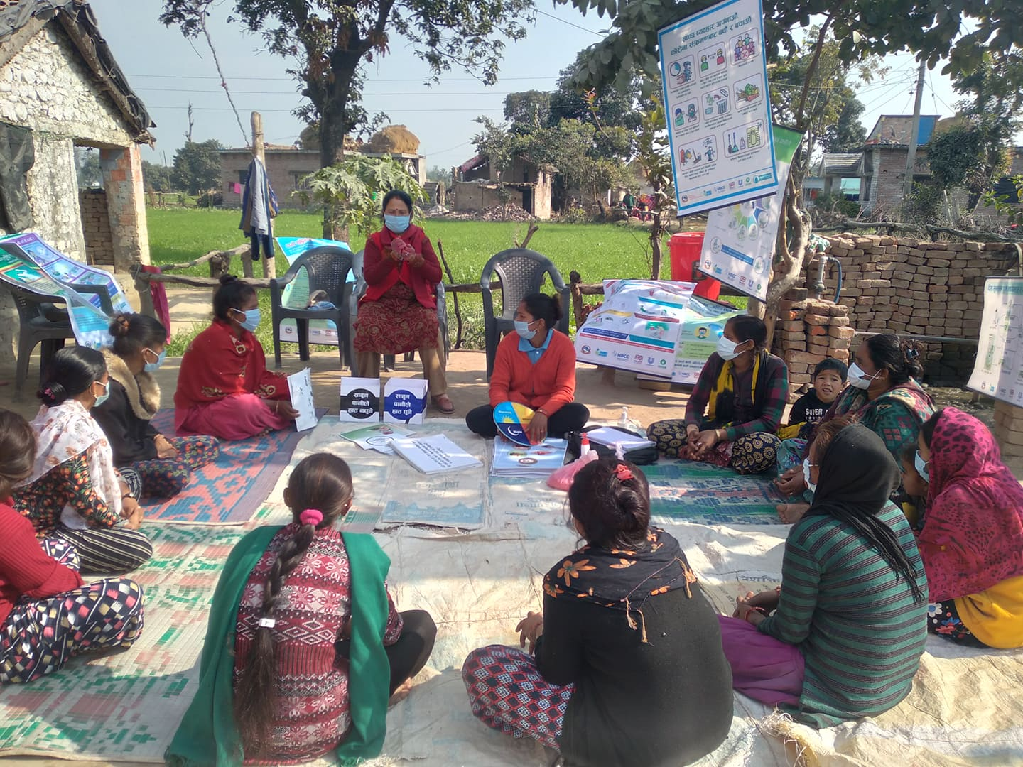
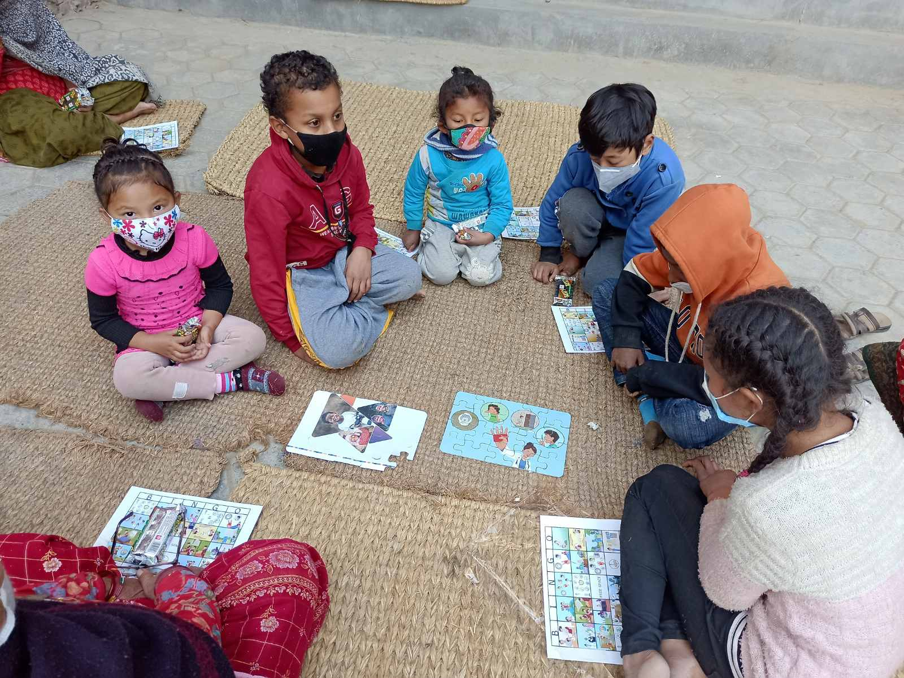
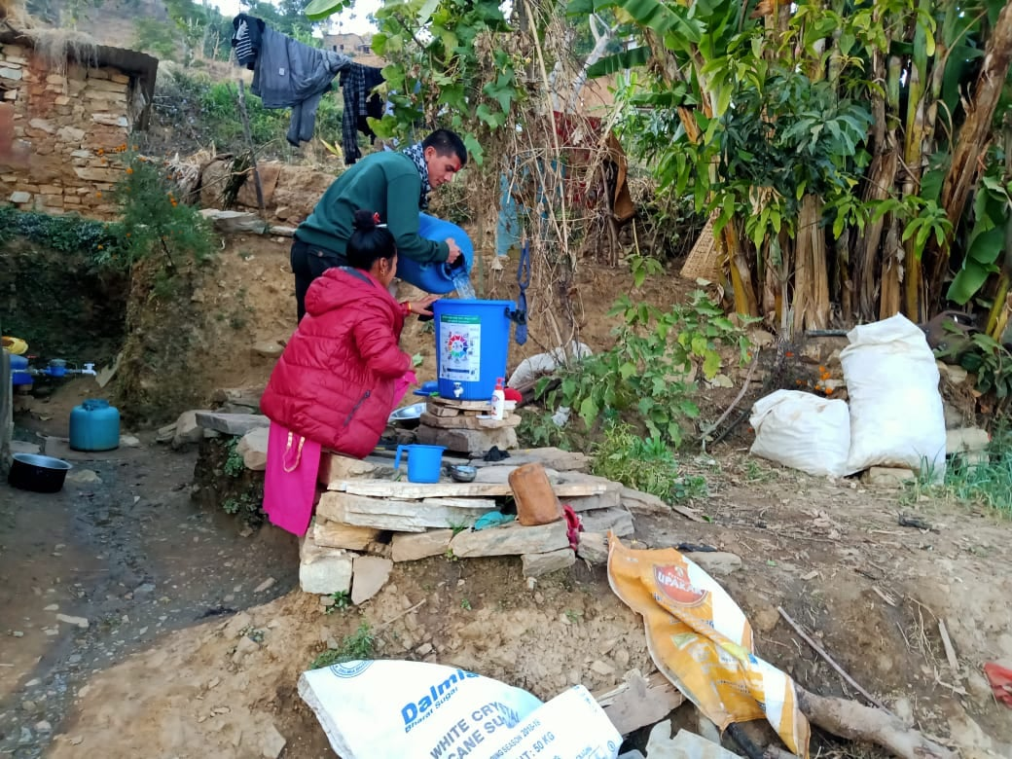
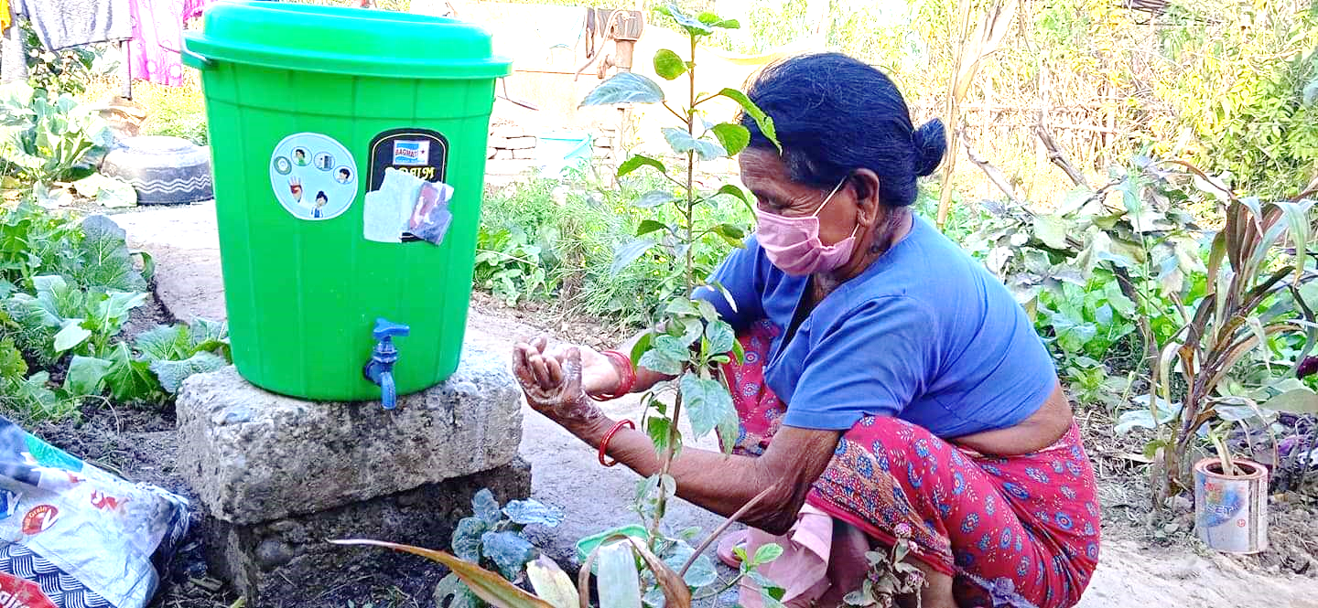
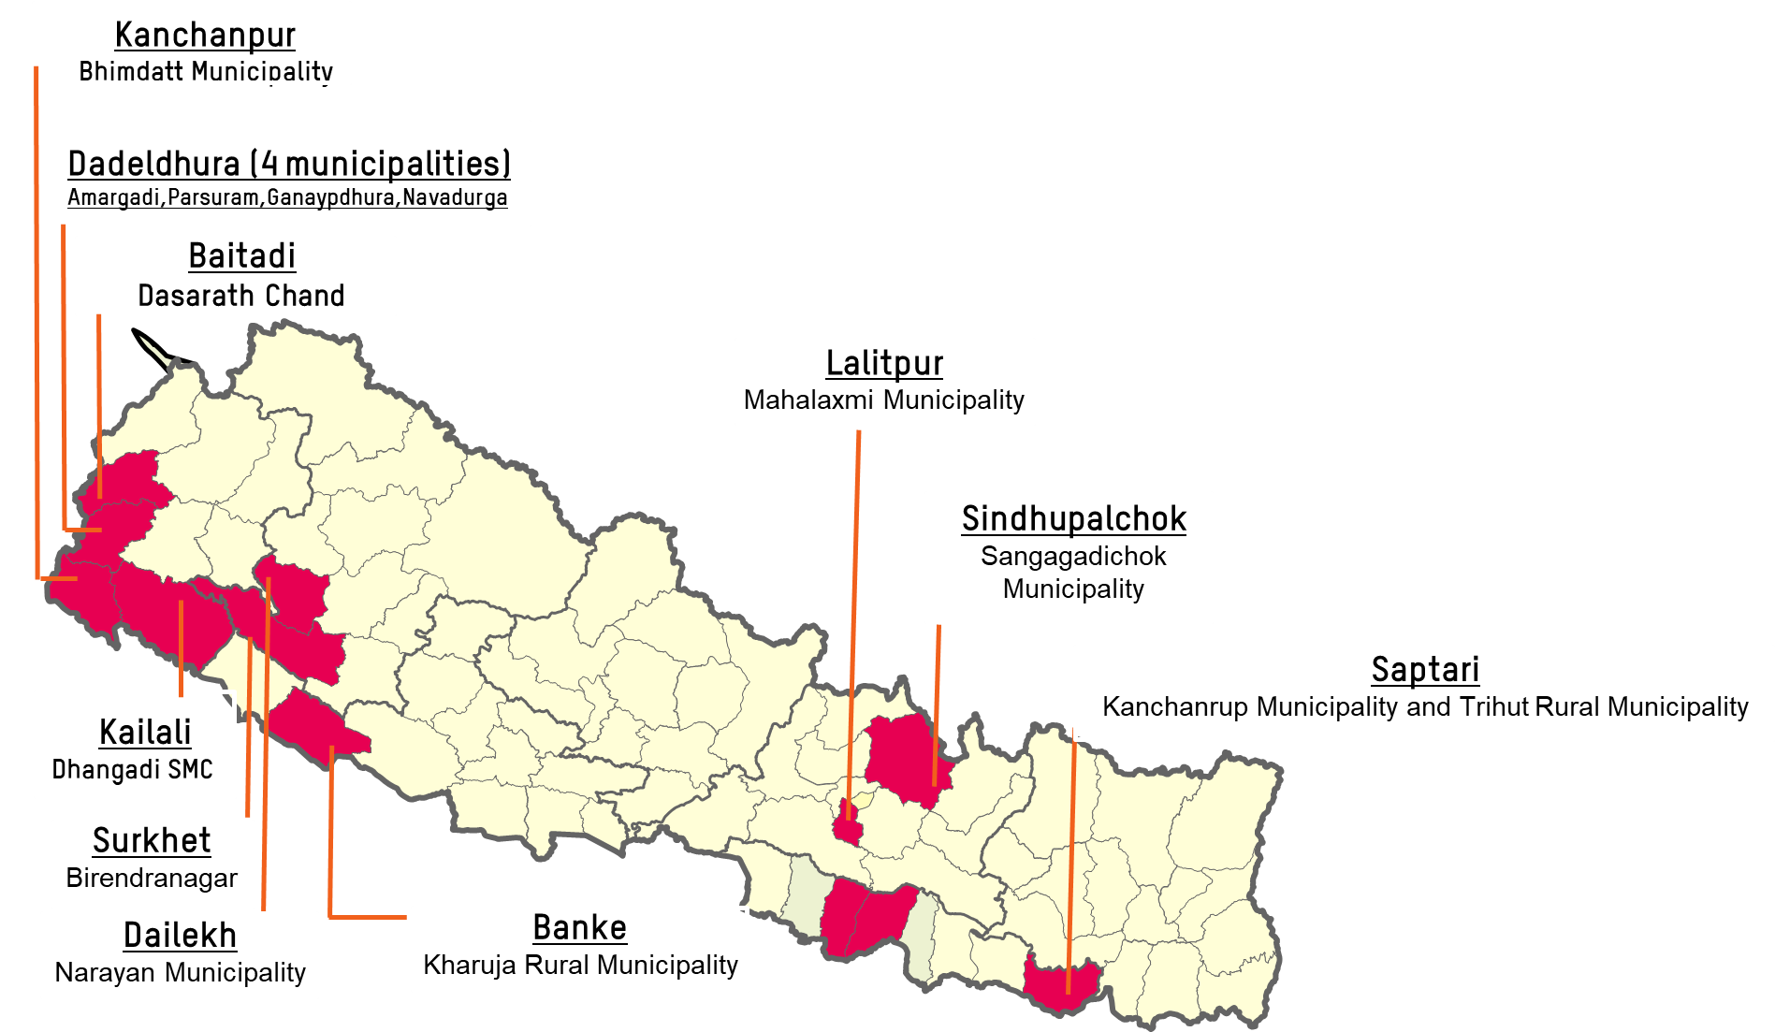
Promotion of Handwashing with soap in the COVID-19 pandemic using emotional motivators
Biju Dangol, Vijay Raj Pant, Radha Subedi, Rameswor Adhikari Upadhaya, Sarika Gurung, Indira Phuyal
Objectives
Sustained improvement in hygiene and health behaviours that limit the spread of COVID-19
Gender norms promote equal distribution of hygiene and health related care work among women and men at the household and community level.
Interventions
Face to face discussion (MMH story board, jizsaw puzzle game, scratch card, colored powder, bingo game, clock game, child magic’s hand, dad’s magic hand)
Mass media- Local TV, digital display, YouTube-MMH documentary
Key Achievements
Knowledge enhancement- Sensitization on Handwashing & gender care work norms by MMH champions
WASH behavior change- frequent handwashing, adoption of COVID preventive measures
Change in gender norms and practices-Reduced Care Work, Increased Awareness on GBV and its reporting mechanism
More influential women’s role in changing behavior – change agents
Social capital building- created social space for learning, sharing & relationship building
Community Voice
“MMH provides message about equal distribution of the care work to male, so it has reduced the workload of female thereby involving in the productive work and we can raise our voices as well”
Local Stakeholder Voice
“There were many positive COVID cases in ward before HBCC project and ward office was closed, but after implementation of hygiene promotional activities, no single case of COVID has been reported with improved health condition of local people”.
Key Learnings
Most effective way of sensitizing community behavior change- use of emotional motivator & silent nudges
New approach in the community (Widely accepted & appreciated )
Innovative and interesting content and methodology attracted mothers and child
Promoted equal distribution of gender care work norms-inspired them to initiate change from themselves (Dad’s Magic Hand)
Inter household cross learning and communication
Integration of care work and gender norms with MMH approach
Table 1 MMH Interventions with Target vs Achievements
Activity | Target | Achievement
MMH Session Conducted | 9,400 | 9,400
Buckets with tap & lid distributed | 15,650 | 15,650
Paddle operated handwashing Stations installed | 223 | 223
Isolation Kits distributed | 3,900 | 2,347
Care Work Reduce and Winterization kits distributed | 3,212 | 3,212
Digital Display & hoarding board Installed | 136 | 136
CPT captured |  | 2,243
Behavioural outcomes of MMH approach
WASH behaviour change
Change in gender norms and practices
Reduced Care Work
Increased awareness of gender-based violence and how to report it
Increase in hand-washing practice
Adoption of Covid-19 prevention measures
Project Locations
Direct Beneficiaries: 90,605 (Receiving buckets, isolation kits, winterization kits)
Indirect beneficiaries: 1,094,075 ((People reached through gender/COVID-19/WASH related awareness raising activities-social media, Radio/FM, digital display)

