Slide 1
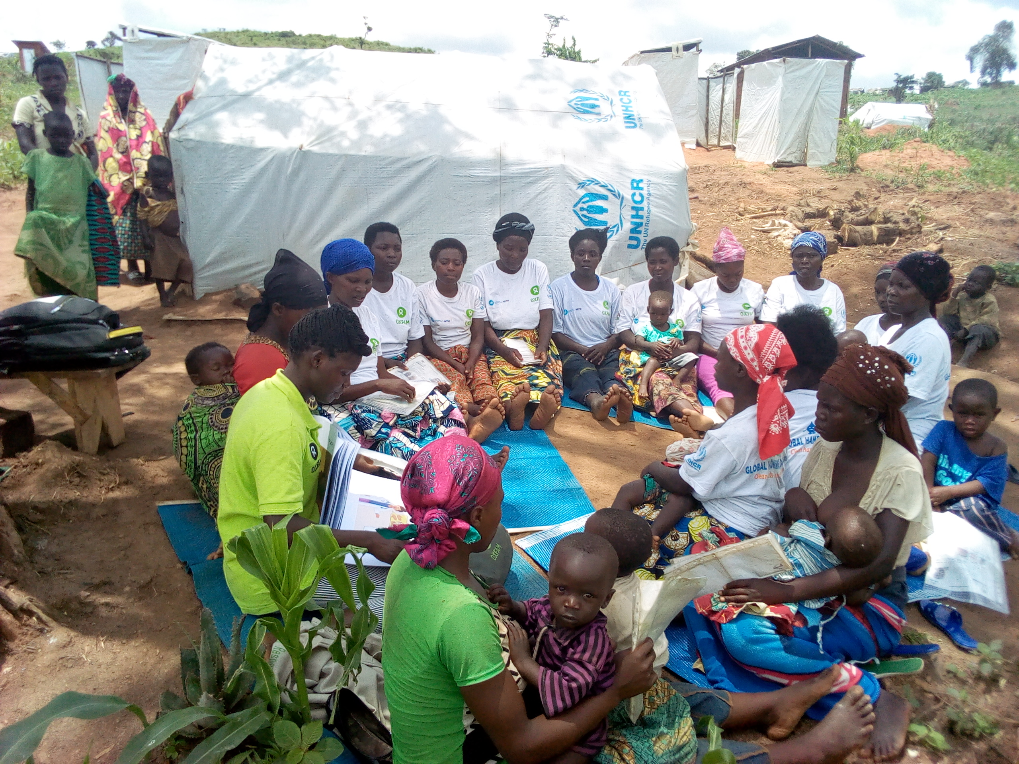



Mums Magic Hands (MMH) – A new Approach to Motivating Handwashing Practice in Emergencies through Storytelling
- Foyeke Tolani, Sonya Sagan and Aarti Daryanani
Notes:
Since 2015, Oxfam and Unilever’s health soap brand Lifebuoy have partnered to create a handwashing with soap programme for use in emergency settings.
The partnership marks a long-standing relationship between the two organisations – but why did we decide to embark on it in the first place?
Our rationale is simple: we want to impact those most in need. This public-private sector partnership pairs Oxfam’s humanitarian and public health response experience with Lifebuoy’s behaviour change expertise and enables us to make a positive difference in promoting health in vulnerable populations.

Slide 2
Outline
Background
Aim, Concept and Development of MMH
MMH Programme
Field Trials
Conclusions
Questions

Slide 3
Background

Slide 4
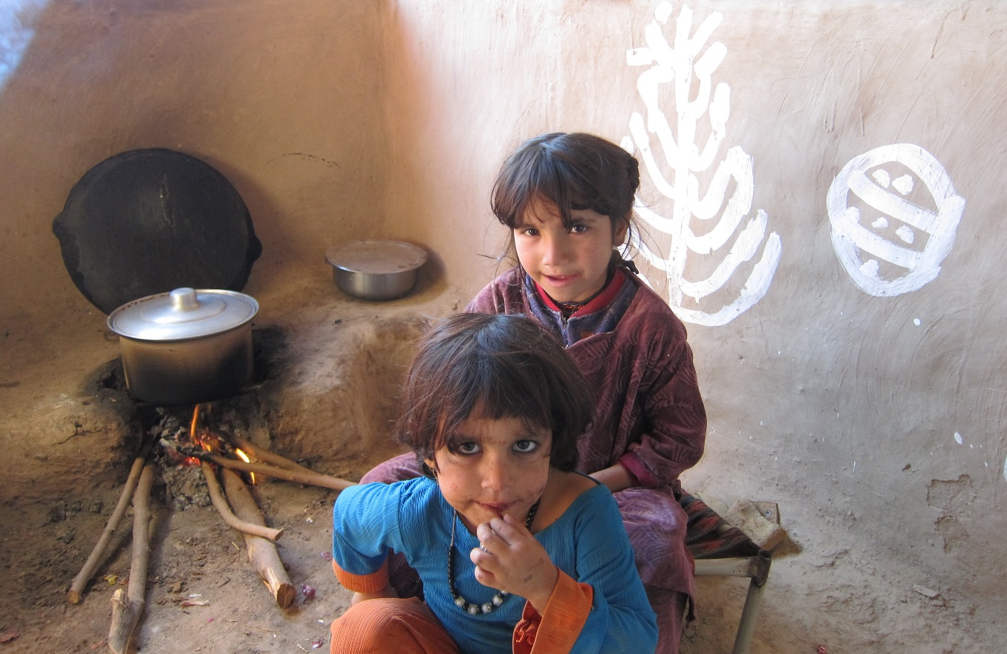
Background
Handwashing can reduce the risk of diarrhoeal disease by up to 50%¹
Nearly 30% of deaths in children displaced by crises are caused by diarrhoea and pneumonia (Ram, 2015)
Diarrhoea alone accounts for +40% of these deaths in the immediate aftermath of an emergency (Connolly et al., 2004)
Notes:
Diarrhea has been identified as the most prevalent disease in emergencies along with acute respiratory infections. Two alarming statistics here, the first that almost 30% of the kids that are displaced because of an emergency loose their lives to D and P. (please add ref before including)
Diarrhoeal disease is amongst the most prevalent in an emergency causing 40% of deaths in children.
The most prevalent diseases during an emergency include diarrhoeal diseases and respiratory infections (please put reference)
Particularly true in the immediate aftermath of an emergency which Is known as the acute phase where diarrhea alone accounts for over 40% of the deaths
Connolly, M.A., Gayer, M., Ryan, M.J., Salama, P., Spiegel, P. and Heymann, D.L. (2004) ‘Communicable disease in complex emergencies: Impact and challenges’, Lancet 364L 1974-83
Ram, P. K. (2015). “Water Hand Sanitizer for Diarrhea Prevention in a Humanitarian Emergency“ Retrieved 9th September 2015, from https://sphhp.buffalo.edu/epidemiology-and-environmental-health/research-and-facilities/research-listings/waterless-hand-sanitizer-in-a-humanitarian-emergency.html

Slide 5
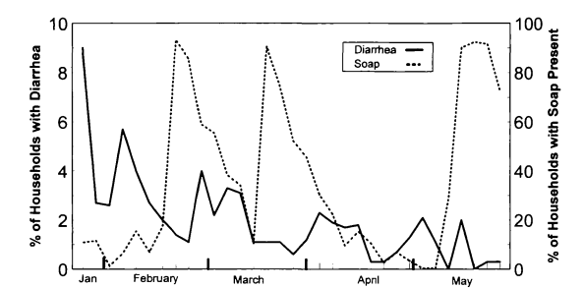
Background
Soap has the potential to reduce diarrhoeal incidence by 27%
Handwashing with soap is proven to breaks the chain of transmission of diarrhoea and respiratory infections.
A study carried out in a refugee camp in Malawi proved the presence of soap in the household was associated to 27% fewer episodes of diarrhoea compared to households where no soap was present
Handwashing in an emergency setting, Malawi, (Peterson et al 1998)
Notes:
Whilst we know that hwws is important in development settings which is the focus is where we work proving to reduce incidence of diarrhea by 48% there is very little documented evidence of hwws behaviour change in these contexts. We know from a study that was done in a camp in Malawi, that giving people access to soap has the potential to reduce DI by 27%
Peterson, E. A., L. Roberts, M. J. Toole and D. E. Peterson (1998). “The effect of soap distribution on diarrhoea: Nyamithuthu Refugee Camp.” International Journal of Epidemiology 27(3): 520-524.
Diarrheaol incidence appears to be lowest when soap presence is the highest – and this increases as soap presence decreases.
Read the paper

Slide 6
Background
Emotional motivators have been used in handwashing promotion in development context but not really used in emergencies.
Oxfam, Unilever’s Lifebuoy soap and Unilever’s Chief Sustainability Office conducted formative research with emergency affected mothers in Philippines, Pakistan and Nepal (2014)
  to better understand what motivates mothers to wash their hands in emergencies.
Nurture and affiliation were cross cutting motivators in the 3 research areas and these were used to develop a set of materials called “Mum’s Magic Hands” designed for handwashing promotion in emergencies.
Notes:
1 - (Curtis and Cairncross, 2003; Fewtrell et al., 2005; Luby et al., 2005).
Nurture -Doing the best for your children
Affiliation - Being a part of a community – the desire to fit in

Slide 7
Aim, Concept and Development

Slide 8

Mums Magic Hands – Aim
Aim
Increase the practice of handwashing with soap and water at 2 occasions:
  before contact with food (eating, preparing food, before feeding your child)
  after contact with faeces (going to the toilet, cleaning your child’s faeces)
To show that visibly clean hands aren’t always clean
Notes:
.

Slide 9
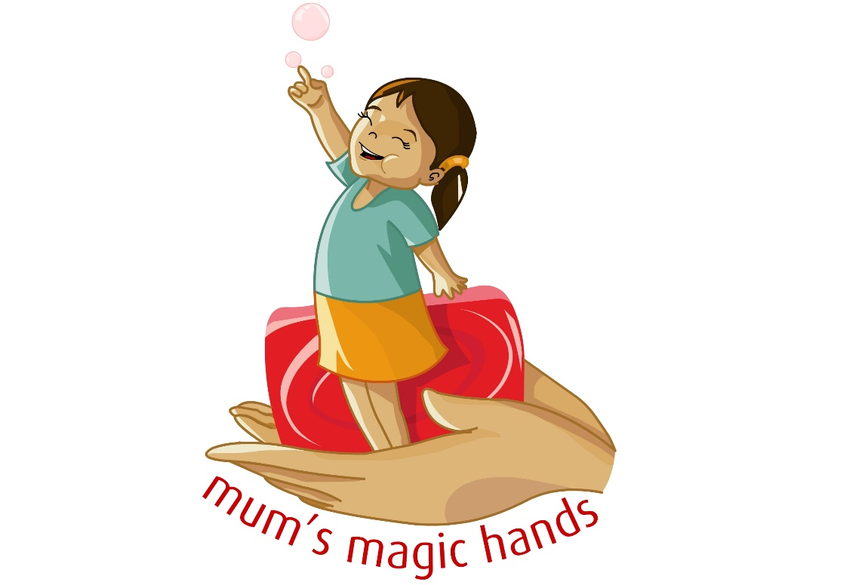
Mum’s Magic Hands - Concept
Mothers have magic hands. Hands that put their children to sleep, that clean them, that help them learn to walk, assuage their little ones by gently stroking when they are in pain. In fact they shape the very life of their children. Hands are perfect metaphors that embody in them, the lives of mothers and their heroic efforts of nurturing their children against all odds.
Hands, on the other hand can also prevent illness. Mother’s magic hands is an idea that marries these two ideas to increase handwashing behaviors.
It reflects
Use of story telling, demonstrations (interactive activities) and nudges
“mum’s magic hands” – a concept that builds on nurture as a key driver of influencing hygiene behavior
Notes:
With these findings we worked together to a create program which builds on mothers magic hands concept but is contexualised to emergencies given what we know now.

Slide 10
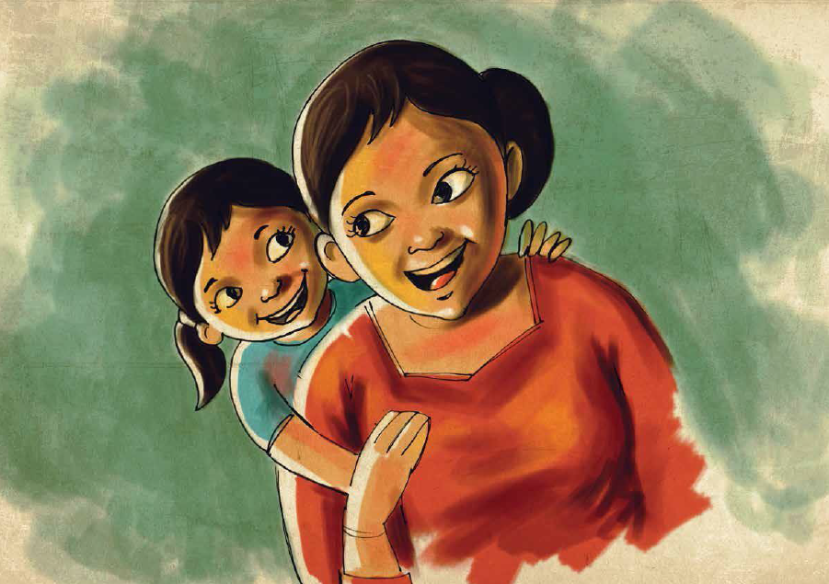
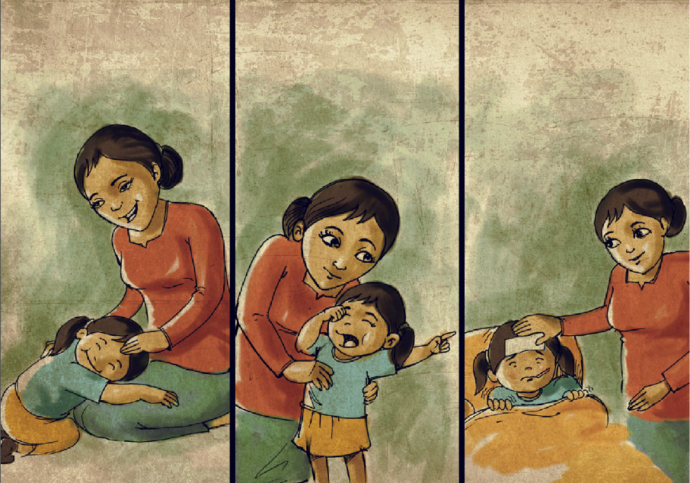
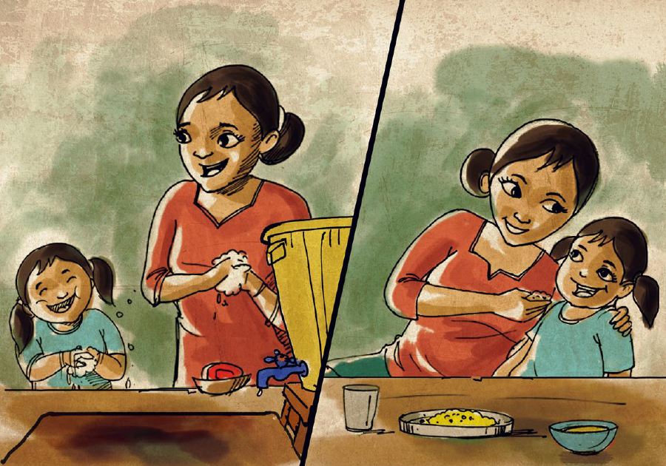
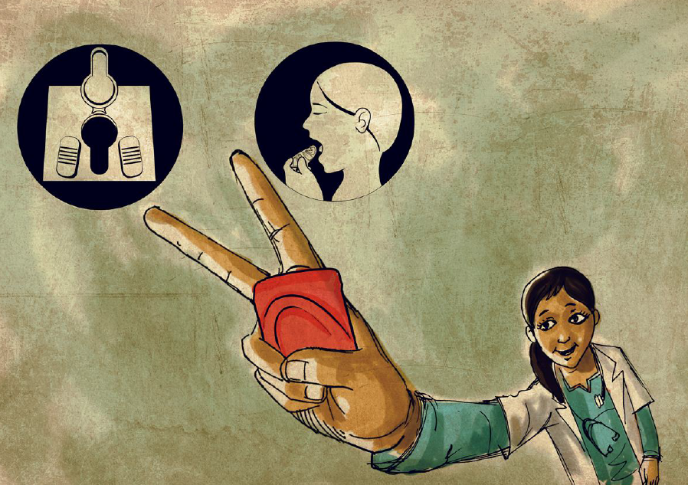
Mum’s Magic Hands - Concept
Mums magic hands is a story that empowers mums living in challenging circumstances to make a difference to their children’s health and future through handwashing with soap
Mum’s magic hands is a story told from the eyes of a little girl in a camp.
Notes:
She talks about her mum’s magic hands which take care of her all day. The same magic hands teach her good habits and particularly how important it is to wash hands with soap after the toilet and before eating because the invisible germs on them will make her sick if she doesn’t. Neighbours admire the healthy and well mannered girl making her and her mother feel proud. Years later, the girl grows up to become a successful doctor, she explains it was her mums magic hands that nurtured her and kept her healthy to make her what she is today .

Slide 11
MMH development
Formative research
Findings reveal nurture and affiliation were common motivators in 3 Asia contexts
Mums Magic Hands further pre-tests
Mums Magic Hands trials in stable contexts
MMH Africa trialed in Nigeria Gwoza and Mubi (2017/18)
MMH Asia creative materials developed in 2015/16
Mums Magic Hands Asia version tested in Zatari camp, Jordan (2016) and Bidibidi camp, Uganda (2016)
MMH was pretested in Nepal and Philippines (2016)
Mum Magic Hands rapid response development and trials
Key findings used to produce Mums Magic Hands Africa (2017) and Mums Magic Hands Global (2017)
MMH Africa trialed camp in Ethiopia - Nguenyyiel (2017)
MMH Global trialed in Uganda Kyaka refugee camp (2018)
MMH Global trial in Nduta camp, Tanzania (2017/18)
MMH Asia trialed in Karachi, Pakistan post flood response (2017)

Slide 12
MMH Main Storyboards (Asia, Africa & Global) and activities

Slide 13
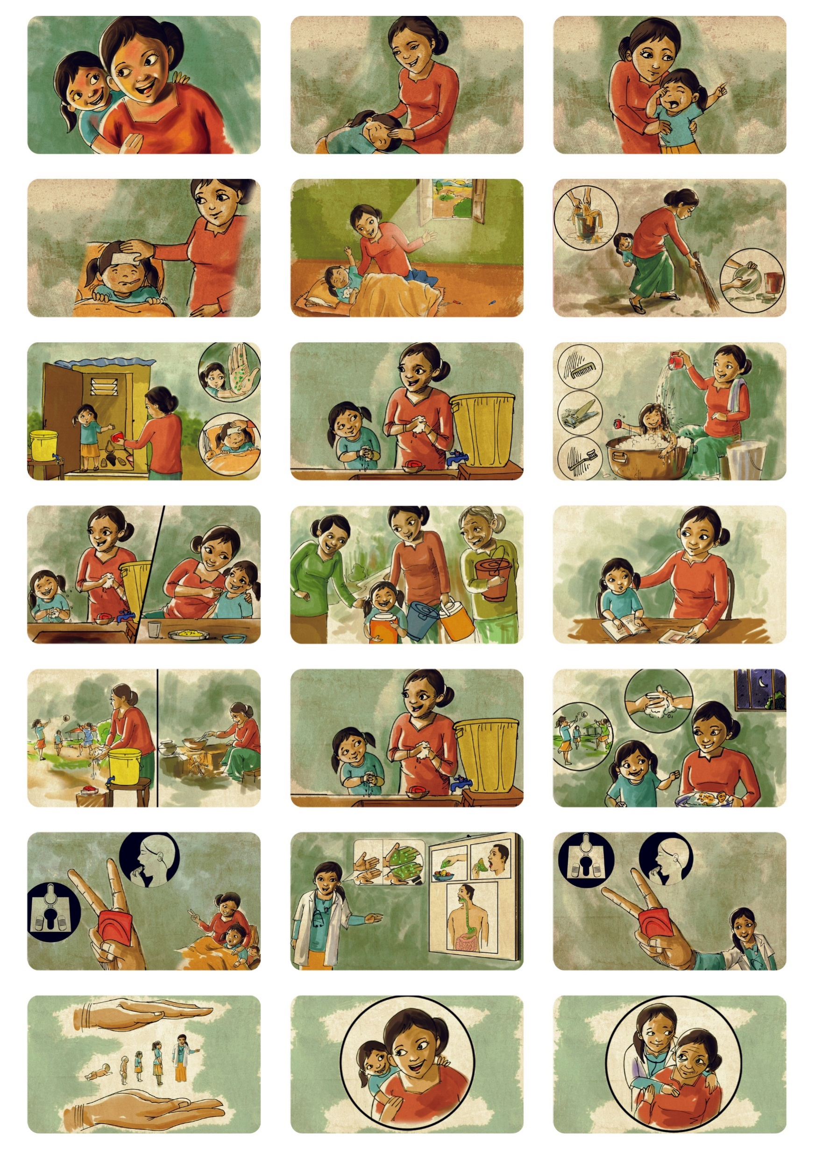
MMH ASIA
Available in the following languages:
Nepali (Nepal)
Urdu (Pakistan)
French

Slide 14
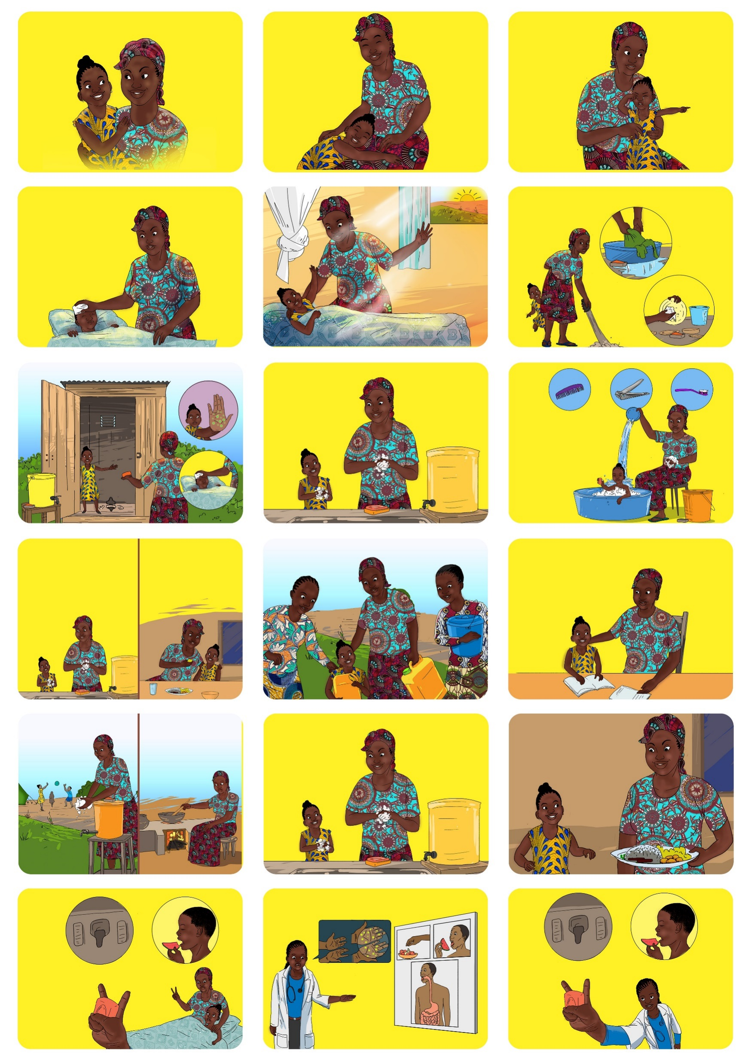
MMH AFRICA
(Low literate)
Available in the following languages:
Nuer (South Sudan)
Hausa (Nigeria)
French
Includes more activities for men (role play, competitions) and children (playing cards)
Notes:
Visuals adapted, images in storyboard more contextual

Slide 15
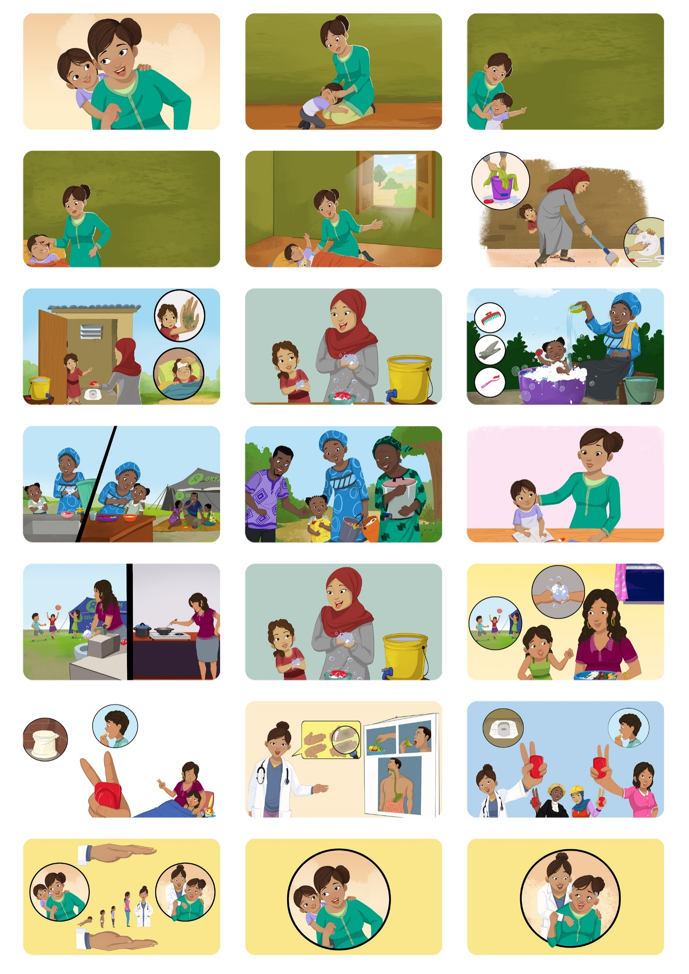
MMH GLOBAL
(MULTICULTURAL)
Available in the following languages:
Burundi (Burundi)
Kiswahili (DRC)
French
Includes more activities for men (role play, competitions) and children (playing cards)
Notes:
Multicultural images that speak to different groups/somewhat literate groups, features more male character in storyboard

Slide 16
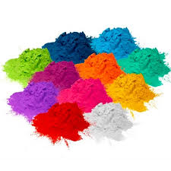
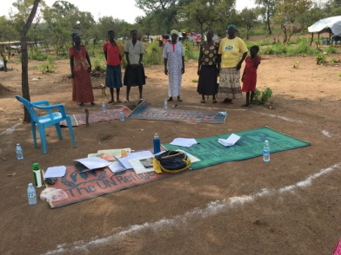
KEY PROGRAMME MATERIALS
A number of materials used in the programme proved popular among the mothers:
Bedtime tale
a contest among participants to develop HWWS at key occasions bedtime stories for their children
Coloured powder exercises
on mothers’ hands to demonstrate that “visibly clean is not clean” and the importance of using soap to remove invisible germs.
Mum’s Magic Hands storyboard
tells the heroic efforts of a mother nurturing her daughter with her magic hands
Scratch cards
removed by a mother every day as a reward to her child for proper HWWS at key occasions practice
Circle of cleanliness
represents a clean area where mothers can only enter after washing their hands
Notes:
Mum’s Magic Hands storyboard is used in group sessions to raise awareness. It tells the story of a mother and her heroic efforts to nurture her daughter with her magic hands. Against all odds and despite the difficult conditions of an emergency context, she is able to instill good handwashing habits in her child which leads to her daughter’s ultimate success in life. The story is based on nurture and affiliation.
Coloured powder exercises demonstrating that “visibly clean is not clean” and the importance of using soap to remove invisible germs, by using coloured powder to help the women understand the difference between hands washed with soap and hands washed only with water – this proved to be a strong motivator for change among the target group
Scratch cards serving as a method to self-monitor handwashing practices in the home by rewarding children with a scratch card of a handwashing story beneath the overlay. Mothers remove one scratch card square per day with their child, to be scratched only when proper HWWS is practiced at two key times by both mother and child, ultimately revealing the next part of the story
Circle of cleanliness to reinforce the importance of handwashing with soap through social pressure and establish affiliation and group norm – by using a circle drawn in coloured powder to represent a clean area where mothers could only enter upon washing their hands
Bedtime tale, a contest among participants to develop HWWS bedtime stories for their children, reinforcing the importance of a mother’s role in ensuring children develop good HWWS habits

Slide 17
All Mums Magic Hands Activities and materials
 | Less Acute/stable context | Rapid/acute/1st phase
Awareness Storyboard | √ | √
Reinforcement Coloured Powder exercise Circle of cleanliness Magic Hands participatory exercise Bedtime tale What goes round Routine dial Playing cards Men’s role play Community meetings | √ √ √ √ √ √ √ √ | √ √ √
Reminders and silent nudges Stickers Posters Nudges – footprint, mirrors etc | √ √ √ | √ √
Rewards Certificates Scratch cards | √ √
Notes:
Mum’s Magic Hands storyboard is used in group sessions to raise awareness. It tells the story of a mother and her heroic efforts to nurture her daughter with her magic hands. Against all odds and despite the difficult conditions of an emergency context, she is able to instill good handwashing habits in her child which leads to her daughter’s ultimate success in life. The story is based on nurture and affiliation.
Coloured powder exercises demonstrating that “visibly clean is not clean” and the importance of using soap to remove invisible germs, by using coloured powder to help the women understand the difference between hands washed with soap and hands washed only with water – this proved to be a strong motivator for change among the target group
iiColoured powder exercise – an exercise using coloured powder and two volunteers to reinforce the idea of invisible germs and HWWS behaviour.
ii. Circle of cleanliness – a circle drawn with coloured powder to represent a pure and clean area whereby one must wash hands with soap before entering.
iii. Magic Hands Participatory exercise – activity reinforces the link between HWWS and the amount of magic in participant’s hands.
iv. Bedtime tale – contest among participants to develop HWWS bedtime stories for their children. Reinforces the importance of ensuring children develop good HWWS habits.
v. What goes around – a set of questions around the affiliation frame of storyboard to reinforce the affiliation driver and its link to HWWS.
vi. Routine dial –reinforces key HWWS key times with mothers and children.

Slide 18
MMH Programme

Slide 19
Programme targets
Primary targets
Mothers were found to be the most significant hygiene influencers. As caregivers, their behaviour was most likely to have an impact on children under 5.
Grandmothers, aunts and older siblings often also care for children, Mum’s Magic Hands targets women of all ages who care for under 5s.
Secondary targets
It’s much easier to change children’s behaviour. Along with motivating them through their mothers, we have also targeted activities for children.
Fathers can also play a role promoting handwashing habits – especially with boys. We also have activities geared towards men.

Slide 20

Pre-existing conditions
Before implementing the programme, make sure
the environment and situation are suitable.
Some pre-existing conditions include:
Handwashing with soap practice is poor/low
Pre-test the storyboard with a sample of the target population
Basic needs should be met – i.e. shelter, food, water, latrine with handwashing station at communal and household levels, hygiene kits etc.
Notes:
Before implementing the programme, make sure the environment and situation are suitable.
If certain conditions aren’t met, the programme may actually frustrate people, rather than motivate them.

Slide 21
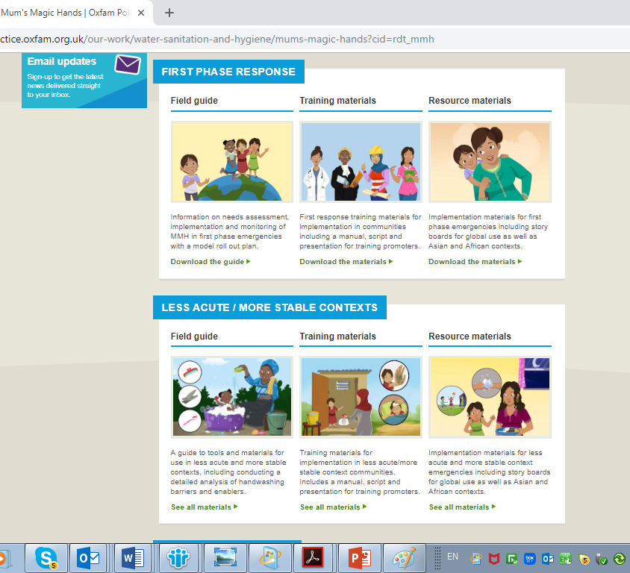
MMH resource materials - website and screen shots www.Oxfam.org.uk/mmh
Notes:
Run through rapid response and less acute program materials
Creative materials – Storyboard, key visuals and images for different interactive activities (Asia, Global and Africa)
Field guide to give step by step guidance on how to use the creative materials
Training guide on how to train implementers
Baseline, monitoring and evaluation guide

Slide 22
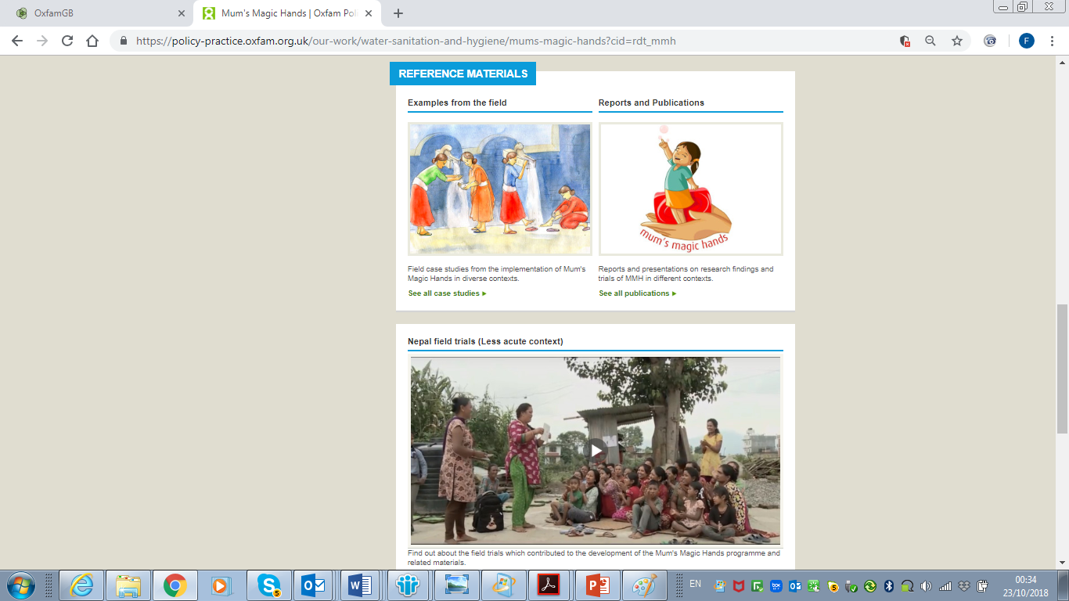
MMH resource materials - website and screen shots www.Oxfam.org.uk/mmh

Slide 23
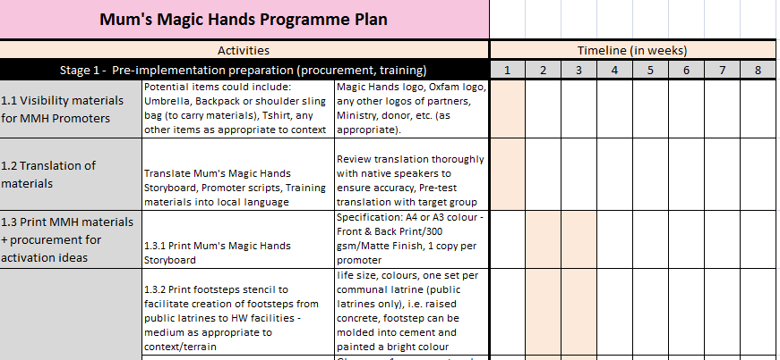
Step-by-step IMPLEMENTATION guide
In the Field Guide there’s a step-by-step guide to rolling out the programme for rapid response/acute and less acute/stable contexts
A sample programme plan with a week-by-week timeline is also available.
Notes:
Highlight pre – implementation activities i.e. Pretest, translation of materials, training of champions etc.
Weeks 1-2
Rapid assessment (ensuring good community entry, consultation and representation) and life saving interventions.
Hardware intervention – stands with hand washing stations, latrines, etc.
Weeks 3-6 (can be shorter/longer depending on context)
Hygiene Promotion (including implementation of rapid Mums Magic Hands).
Soap and visual activation ideas material distribution, awareness raising using the MMH storyboard and reminders through group sessions and activities.

Slide 24
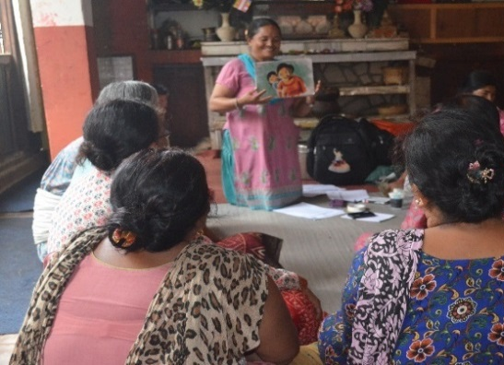
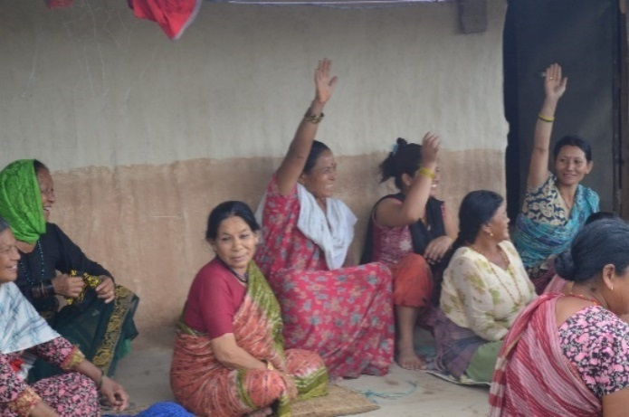
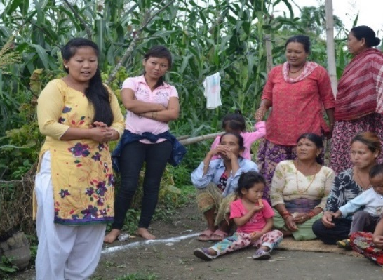
RAPID RESPONSE PROGRAMME SESSIONS
Session 1:
Exercises to assess HWWS at key occasions practice with mothers, introduction of storyboards, facilitation of action planning
Session 2:
Review of progress on action plans, activities to reinforce HWWS at key occasions and further planning for household and community
Session 3 or more:
Ongoing activities and community meetings; Providing reminders of handwashing with soap practices through men’s role play and community activities
Notes:
There is no mention of the Emotional Motivators here; it’s not brought to life

Slide 25
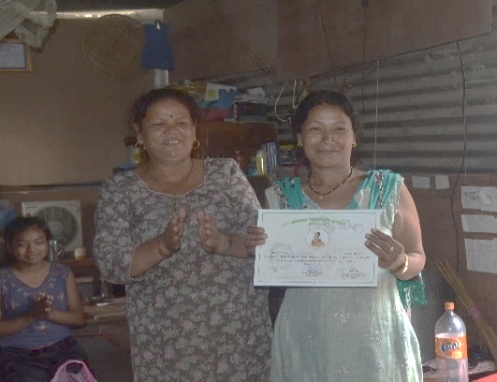
LESS ACUTE/STABLE CONTEXT PROGRAMME SESSIONS
Week 1:
Exercises to assess HWWS at key occasions practice with mothers, introduction of storyboards, facilitation of action planning
Week 2:
Review of progress on action plans, activities to reinforce HWWS at key occasions and further planning for household and community
Week 3:
Providing reminders of handwashing with soap practices
Week 4 & 6:
Review of action plans and presentation of certificates to reinforce affiliation among the group and to reward mothers for participating in the programme
Notes:
This comprises of a number of sessions that incorporate visual materials and activities to promote, remind and reinforce - handwashing with soap at home and in the community.
Week 1
Assessment of HWWS practice at key occasions with mothers, exercises using storyboard, coloured powder exercise, scratch cards, facilitation of action planning and soap and sticker distribution
Week 2
Voting exercise, storyboard, circle of cleanliness, what goes around, bedtime tale and participatory exercises
Week 3
Voting exercise, storyboard, soap distribution, scratch cards, action planning, circle of cleanliness and routine dial
Week 4 & 6
Voting exercise, storyboard, scratch cards, action planning, circle of cleanliness and certificates.
There is no mention of the Emotional Motivators here; it’s not brought to life

Slide 26
FIELD TRIALS

Slide 27
NEPAL
Evaluation Methodology – combined quantitative and qualitative methods
Knowledge, attitude and practice (KAP) survey
Previous day sticker diary
Structured observation
Focus Group Discussions
Key Informant interviews
Location – Kirtripur, Nepal (2015)
Type of storyboard – Asia version
Program – Stable context
Adaptation – none, translated to local language

Slide 28
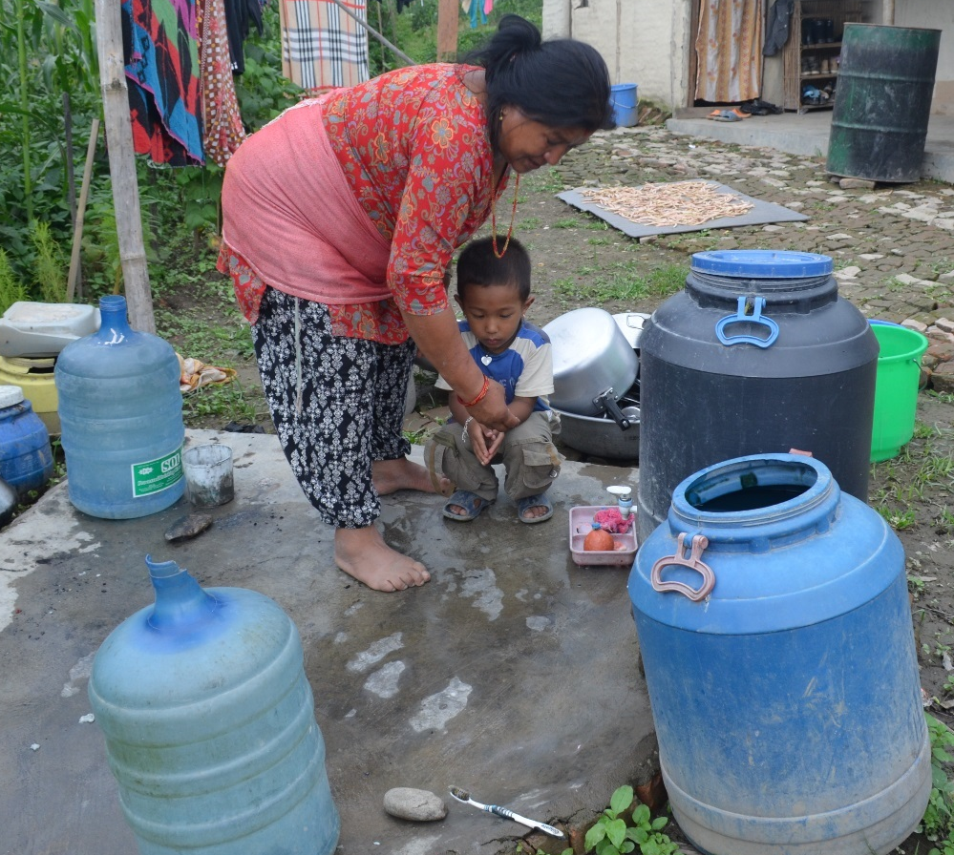
NEPAL RESULTS
increase in handwashing with soap knowledge before eating. Also 45% increase of HWWS after using the toilet *
45%
28%
increase in handwashing with soap knowledge before preparing food
18%
increase in handwashing with soap practice before eating
17%
increase in handwashing with soap practice before preparing food
Notes:
The results were largely positive with an increase in both awareness and practice of handwashing with soap both before eating and after cooking. Nurture was found to be a significant motivating factor among mothers.
*There was also an 45% increase of HWWS for mothers after using the toilet - this may also be due to other factors like increase access to handwashing station and water
These results helped us to design the development of the programme

Slide 29
Nepal Lessons Learnt
Storytelling has proven to be a good form to encourage uptake of hygiene practices, program was engaging securing +90% attendance
Nudges and materials used as reminders were popular and helps reinforce good practice
providing enabling environment for handwashing e.g hygiene needs like soap, handwashing station, water help facilitate handwashing practice

Slide 30
Nigeria
Location – Pilot in 3 communities in Madagali LGA, Adamawa State, Northeast Nigeria
Type of storyboard – Unstable context /African version
Program Adaptation – 4 activities; translation to Hausa language.
Constraints
The fragile security context had limitations on implementation and data collections during the pilot and regular meetings
Key findings/Lessons learnt
100% of mothers/carers (208) who participated reported increase in handwashing
Mothers could easily resonate with the story of the girl in the storyboard.
Interactive group meeting in MMH found effective in promoting HW practice because it brings people together to discuss problems and take action to address them.
Promotional materials used in the pilot (posters, stickers) served as key reminders in promoting HW at key times
Despite living in such fragile context, mothers could invest time and efforts to use locally available materials for handwashing in the households
Success in community action was achieved without monetary incentives
Men actively participated
Notes:
Context - – Lake Chad Basin Humanitarian Response , Northeast Nigeria. A Fragile and unstable security context that affected more than 175, 000 people in Adamawa state. Thousands fled their homes, sheltering in camps, but more often sharing resources and living with host communities. Armed Opposition Groups (AOGs) continued to attack security forces, militia, and civilian targets across the State on an almost daily basis. Military operations continued, often moving rural communities into “secured” towns – either voluntarily or as part of a strategy to deny AOGs any support. Oxfam’s WASH interventions had impact on the most acute WASH needs, and in particular those that impact on malnutrition, resulting from the conflict, insecurity and displacement.

Slide 31
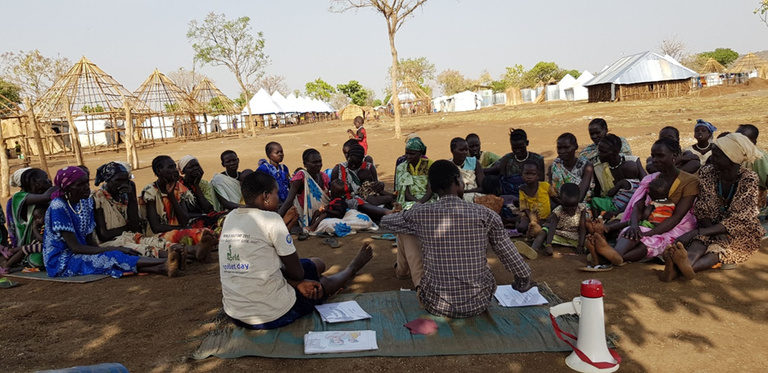
Ethiopia
Location – Gambella South Sudanese Refugees (Nguenyyiel camp)
Type of storyboard – contextualized: Nuer plus drawings by local artist
Program – Stable context
Adaptation – actual sessions with community done in 2 weeks with 160 mothers
Constraints –
i) lack of an enabling environment to sustain handwashing behaviour (such as inadequate water; limited number of water containers and communal latrines)
ii) Inability of the HCOAs to run the sessions individually (mainly due to illiteracy)
Key findings/lessons learnt:
Slight increase in knowledge of HW before eating and after using the toilet
Observed handwashing inconclusive due to too many constraints
Pictures of locals & audio recording of the translated story save time
Integrating Mum’s Magic Hands project within a broader WASH program that creates an enabling environment is more effective
Success of the project is heavily pegged on the MMH promoters/ volunteers’ understanding of the activation ideas
Use of awards in an illiterate community is a strong motivator for participation
Preparation/planning stage needs time!

Slide 32
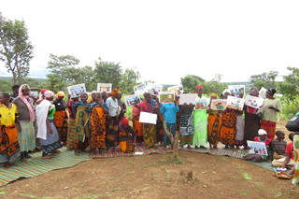
Tanzania
Location
  Nduta Refugee camp (2017/18)
Type of storyboard
  Multicultural
Program
  Stable context
Adaptation
  Content well adapted to the local context
Implementation Constraints-
  Poor quality of materials
  Repatriation exercise caused drop out between week 6 and 8
Key findings/ lessons learnt
Limited knowledge on key times for Handwashing with soap before introduction of MMH
Message diffusion
  men reported to have received the messages from their spouses
Increase and improved handwashing practice
Handwashing with soap sited as the main message
  two key occasions commonly referenced
  Jigsaw puzzle referenced by children as their favourite
Approach seen as unique by participants especially use of graphics and other materials
Other than disease prevention, mothers felt motivated to practice handwashing to ensure successful future for their children
Notes:
Those who had some idea key times for handwashing could only mention 2 times out of the 5 critical times for handwashing (before eating and after latrine use
Participants felt that the MMH concept had an impact in their lives and should have been introduced to all the other zones within the camp.
A 36 year old mother, mother of 5 said “I have children and I wish one day they can be successfully like the child I heard from the story and with the teachings I have benefited from the program, I will help my children to grow healthy’’
A 53 year old mother of 4 children, whose level of education is standard 4 replied,’’ the main n message was to take care of our family especially children by using magics found in our hands through handwashing, and the message was relevant to me and my family …. also as a mother it’s my responsibility to take care of my children and encouraging them to adopt hygiene behaviors so that they can grow healthy and happy’’

Slide 33
Uganda
Key findings
Mothers had initial speculations about MMH but later fully engaged and increased HW practice
Children felt they should have been more involved, as expressed by an 11-year-old girl, “They should put us in the program and tell us about Mena directly.”
Observed improvement in general hygiene in addition to handwashing practice
Coloured powder exercise and circle of cleanliness had lasting impact
Visuals sited as key reminders to handwashing
Location
  Kyaka II settlement (2018)
Type of storyboard
  Multicultural
Program
  Rapid Response/Acute context
Adaptation
  Well adapted without changes to storyboard
Constraints
  Mobile nature of the refugees
  Settlement context
  Poor quality of locally procured materials
Notes:
Need to have more sessions/activities for children
During evaluation the environment was clean free from open defaecation compared to baseline

Slide 34
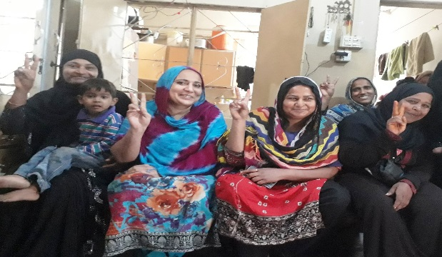
Other Examples
Pakistan (Post flood in Karachi)
Adapted Asia version pretested with 200 mothers in urban slum area
Increase in HW knowledge at key times
Increase in observed proper HW 33.9% - 77.1%
Lessons learnt
Pre-test is important and it should be done at least a week before programme roll out for incorporating all the concerns from the community into the materials and to ensure smooth implementation.
Getting mothers to commit to 2 hours meeting and 4 sessions was challenging
Bangladesh Rohinga Refugee Response (2018)
Pretest completed by ACF and Oxfam
Next steps:
Update the story board to add scarves and change the clothing slightly on the story board;
Change final frame to the girl becoming a teacher rather than a doctor.
Roll out of MMH by ACF and Oxfam in the first instance to support volunteers to facilitate the sessions
Scale up to other NGOs
Notes:
HANDS, Pakistan - Successfully delivered sessions on importance of hand washing with soap at community level with 200 mothers at Burfat Mohalla as per MMH approach. A positive change observed not only in mother’s knowledge, attitude and hygiene practices but also their children after attending the regular sessions.
One of the mothers said during field visit, “this approach was so creative and engaging that now my six-year-old daughter remind of washing hands before starting any meal”.

Slide 35
Conclusions
Pretesting of storyboard is very important
Providing enabling environment (water, handwashing stations etc) enhances handwashing practice with soap and water
Community consultation is important and engaging men and children as well
Adapt MMH based on context, literacy level, culture (religion/dressing)
In unstable/acute emergency context, use the rapid response package
MMH has proved to be effective, interactive, participatory and empowering, reaching different members of the family and community

Slide 36




Ongoing pilot/implementation in Yemen
Ongoing pilot/implementation in Myanmar (Oxfam and ACF)
Ongoing implementation in India
Scale up of MMH through adoption and implementation by other NGOS, government etc.
Community of practice established for learning and sharing (please write handwashing@Oxfam.org)
Publication and sharing of completed MMH responses

Slide 37
Acknowledgements
Claudia Codsi, Hina West, Sarah Marioni and Cat Batchelor, Corporate partnerships, Oxfam
Marion O’Reilly, Lucy Knight, Raissa Azzalini, Betty Ojeny, Caroline Muturi, Grace Mbabazi, Abie Bangura, Meriam Asibal, Michelle Farrington and Riaz Hussain (Oxfam)
Anila Gopal, Aarti Daryanani and Arathi Unni, Lifebuoy Global
Eric Ostern and Jonathan Gill, Chief Sustainability Office, Unilever
Notes:
Thank you

Slide 38

Questions

Slide 39


