Slide 1

Mums Magic Hands (MMH) – An Approach to Motivate Handwashing Practice in Emergencies through Storytelling
Mum’s Magic Hands Introduction Training
for HBCC Partners
08 October 2020 @ 8:00 AM - 11:00 AM London Time

Slide 2
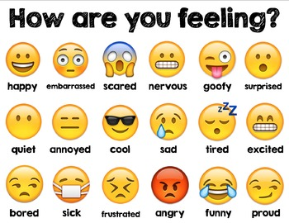
Circle or tick using Annotate

Slide 3

Expectation

Slide 4
TRAINING AGENDA
Mum’s Magic Hands Introduction Training for HBCC Partners (3 Hours)
# | Agenda | Facilitators | Time
1 | Introduction, Expectations, Objectives, Training norm/rules |  | 10 Min
2 | What is MMH, how/why it was developed Background (HW & Disease analysis), MMH Aims, Concepts & Development |  | 15 Min
3 | Overview of programme implementation & storyboard MMH storyboards versions Key programme materials & Assets designed Details: Activities, Materials, Channels MMH Programme |  | 20 Min
4 | MMH Session Flow
 | Group Task 1: MMH Storyboard Pre-Testing |  | 25 Min
 | MMH at a glance: Stages/Steps Step Guide |  | 20 Min
 | Promoters key consideration, skills, Adult learning approach |  | 10 Min
 | Group Activity 2: Storyboard (Q&A) & Group Presentation |  | 30 Mn
 | Group Activity 3: Activities Practice & Group Presentations |  | 30 Min
5 | Question & Answers |  | 10 Min
6 | Feedback. Wrap up & Action Points |  | 10 Min

Slide 5
Rules/Norms of the training

Slide 6
Session 1: What is MMH, How/Why it was developed
(20 mins)
  Background (Handwashing & Disease analysis)
  MMH Aims & concepts (emotional motivators)
  Development

Slide 7

What comes in your mind when you hear about MMH??

Slide 8
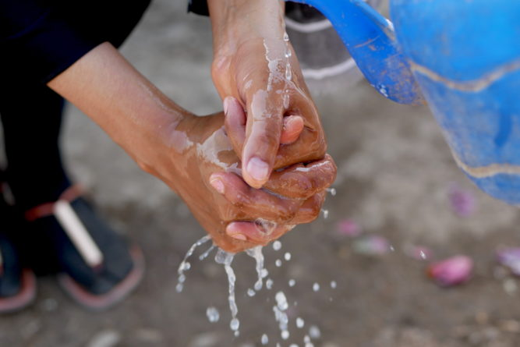
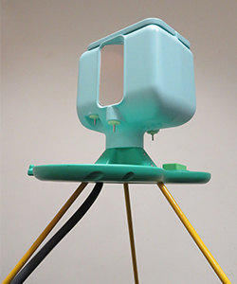
Background
Handwashing Global analysis:
Handwashing can reduce the risk of diarrhoeal disease by up to 50%¹
Nearly 30% of deaths in children displaced by crises are caused by diarrhoea and pneumonia (Ram, 2015)
Diarrhoea alone accounts for +40% of these deaths in the immediate aftermath of an emergency (Connolly et al., 2004)
Notes:
Diarrhea has been identified as the most prevalent disease in emergencies along with acute respiratory infections. Two alarming statistics here, the first that almost 30% of the kids that are displaced because of an emergency loose their lives to D and P. (please add ref before including)
Diarrhoeal disease is amongst the most prevalent in an emergency causing 40% of deaths in children.
The most prevalent diseases during an emergency include diarrhoeal diseases and respiratory infections (please put reference)
Particularly true in the immediate aftermath of an emergency which Is known as the acute phase where diarrhea alone accounts for over 40% of the deaths
Connolly, M.A., Gayer, M., Ryan, M.J., Salama, P., Spiegel, P. and Heymann, D.L. (2004) ‘Communicable disease in complex emergencies: Impact and challenges’, Lancet 364L 1974-83
Ram, P. K. (2015). “Water Hand Sanitizer for Diarrhea Prevention in a Humanitarian Emergency“ Retrieved 9th September 2015, from https://sphhp.buffalo.edu/epidemiology-and-environmental-health/research-and-facilities/research-listings/waterless-hand-sanitizer-in-a-humanitarian-emergency.html

Slide 9
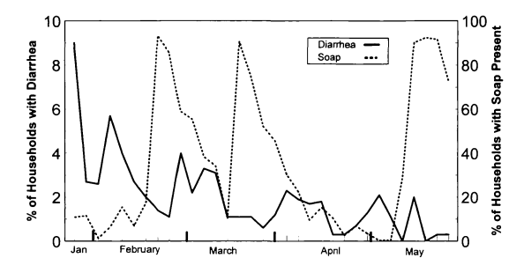
Background
Soap has the potential to reduce diarrhoeal incidence by 27%
Handwashing with soap is proven to break the chain of transmission of diarrhoea and respiratory infections.
A study carried out in a refugee camp in Malawi proved the presence of soap in the household was associated to 27% fewer episodes of diarrhoea compared to households where no soap was present
Handwashing in an emergency setting, Malawi, (Peterson et al 1998)
Notes:
Whilst we know that hwws is important in development settings which is the focus is where we work proving to reduce incidence of diarrhea by 48% there is very little documented evidence of hwws behaviour change in these contexts. We know from a study that was done in a camp in Malawi, that giving people access to soap has the potential to reduce DI by 27%
Peterson, E. A., L. Roberts, M. J. Toole and D. E. Peterson (1998). “The effect of soap distribution on diarrhoea: Nyamithuthu Refugee Camp.” International Journal of Epidemiology 27(3): 520-524.
Diarrheaol incidence appears to be lowest when soap presence is the highest – and this increases as soap presence decreases.
Read the paper

Slide 10
Background
Emotional motivators have been used in handwashing promotion in development context but not really used in emergencies.
Oxfam, Unilever’s Lifebuoy soap and Unilever’s Chief Sustainability Office conducted formative research with emergency affected mothers in Philippines, Pakistan and Nepal (2014)
  to better understand what motivates mothers to wash their hands in emergencies.
Nurture and affiliation were cross cutting motivators in the 3 research areas and these were used to develop a set of materials called “Mum’s Magic Hands” designed for handwashing promotion in emergencies.
Notes:
1 - (Curtis and Cairncross, 2003; Fewtrell et al., 2005; Luby et al., 2005).
Nurture -Doing the best for your children
Affiliation - Being a part of a community – the desire to fit in

Slide 11
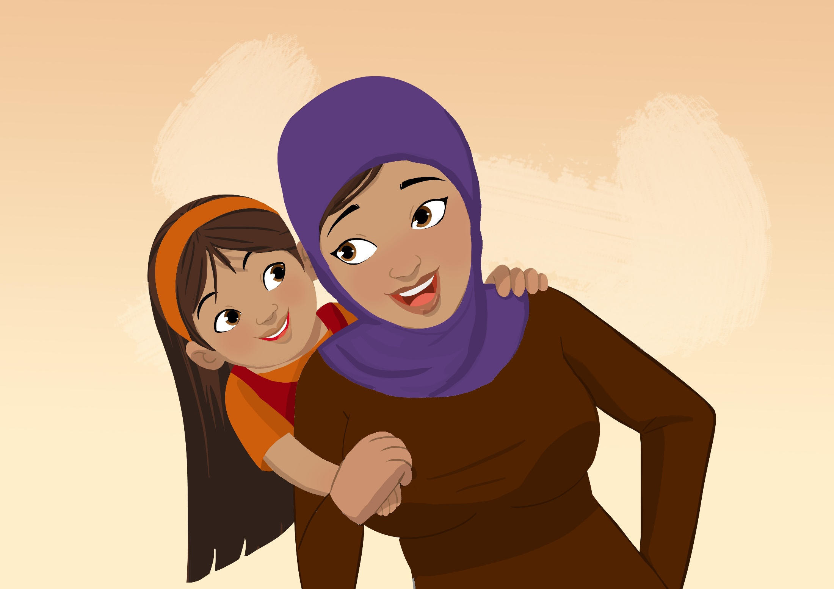
Mums Magic Hands(MMH)
Aim, Concept and Development

Slide 12
Mums Magic Hands – Aim
Aim
Increase the practice of handwashing with soap and water at 2 occasions:
  before contact with food (eating, preparing food, before feeding your child)
  after contact with faeces (going to the toilet, cleaning your child’s faeces)
Because of Covid-19 situation is adapted and added 2 more occasions
  After coughing/sneezing
  Before entering house immediately after coming indoors
To show that visibly clean hands aren’t always clean
To prevent COVID 19 virus transmissions
Notes:
.

Slide 13

Mum’s Magic Hands - Concept
Mothers have magic hands. Hands that put their children to sleep, that clean them, that help them learn to walk, assuage their little ones by gently stroking when they are in pain. In fact they shape the very life of their children. Hands are perfect metaphors that embody in them, the lives of mothers and their heroic efforts of nurturing their children against all odds.
Hands, on the other hand can also prevent illness. Mother’s magic hands is an idea that marries these two ideas to increase handwashing behaviors.
It reflects
Use of story telling, demonstrations (interactive activities) and nudges
“Mum’s Magic Hands” – a concept that builds on nurture as a key driver of influencing hygiene behavior
Notes:
With these findings we worked together to a create program which builds on mothers magic hands concept but is contexualised to emergencies given what we know now.

Slide 14
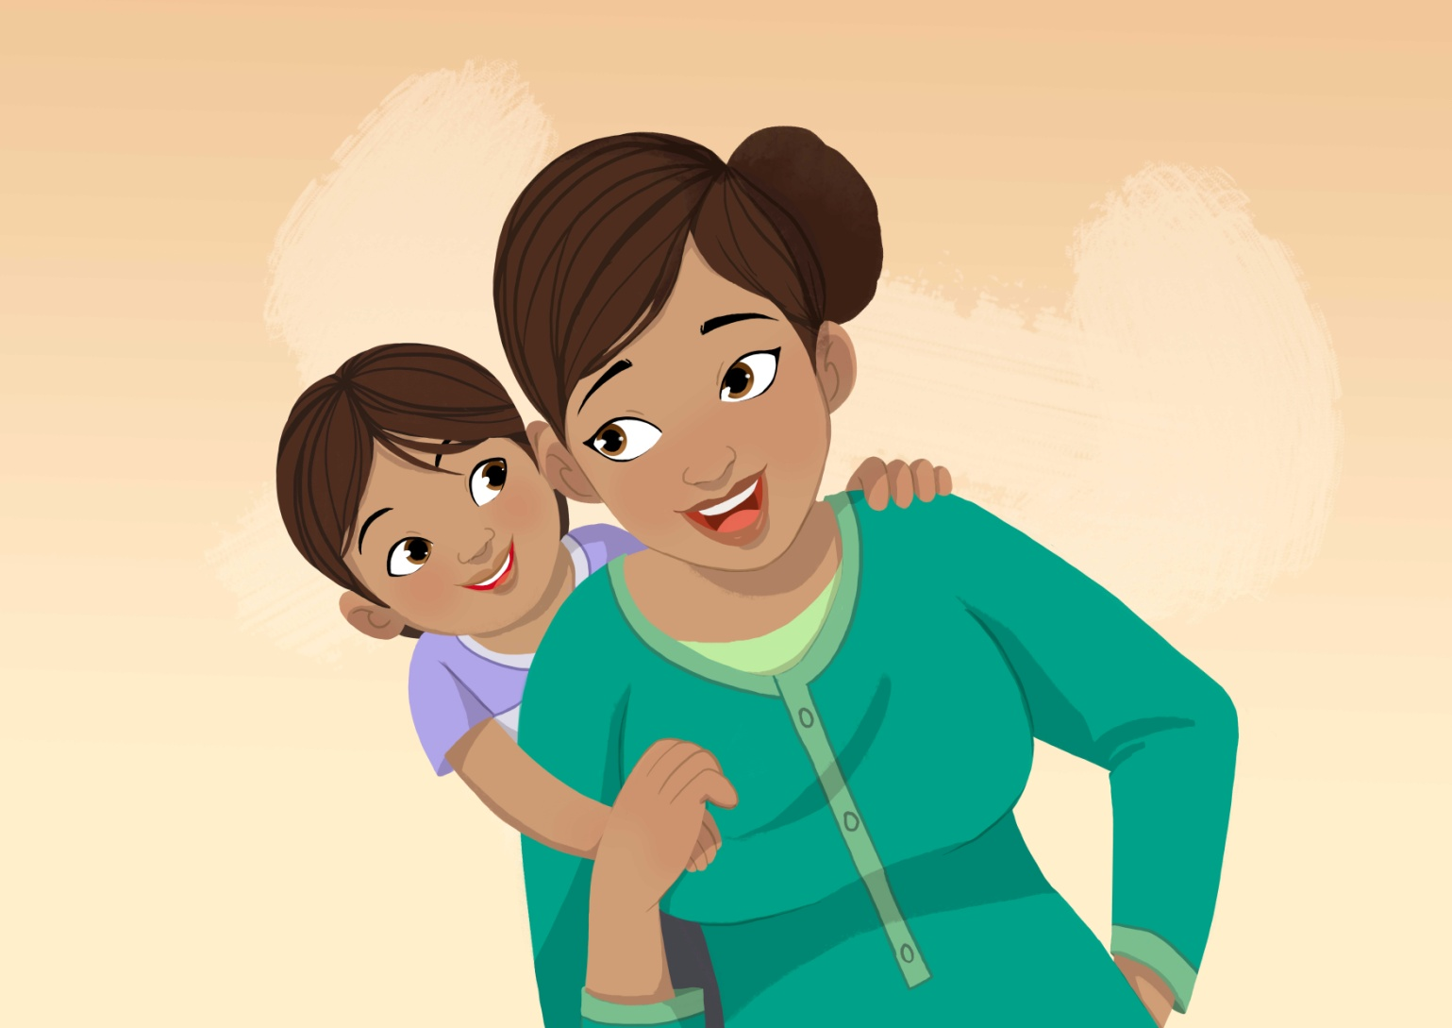
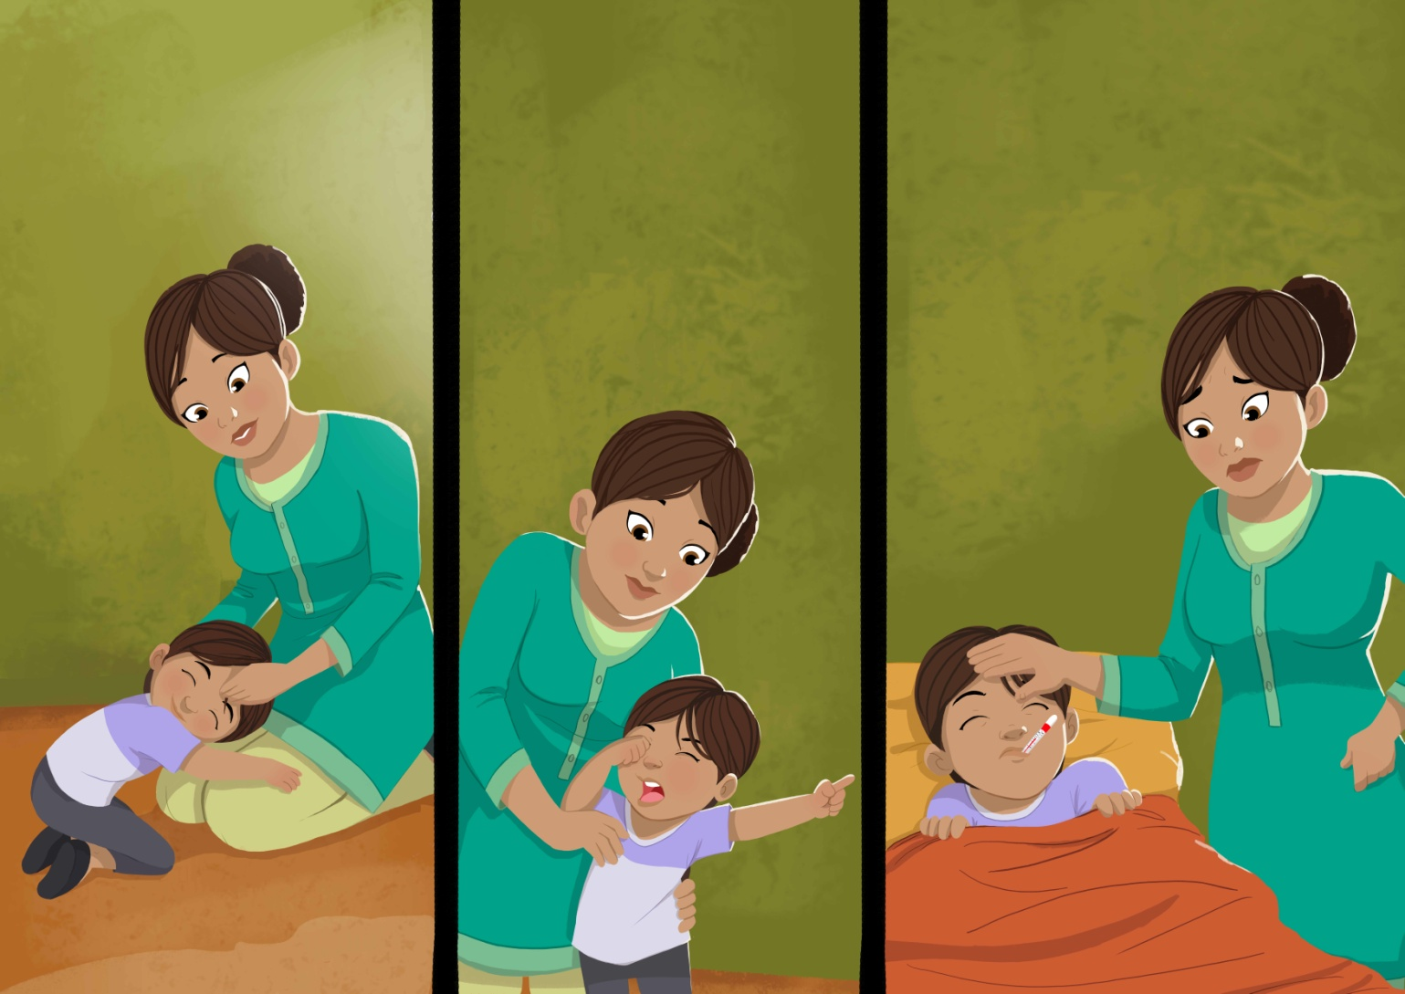
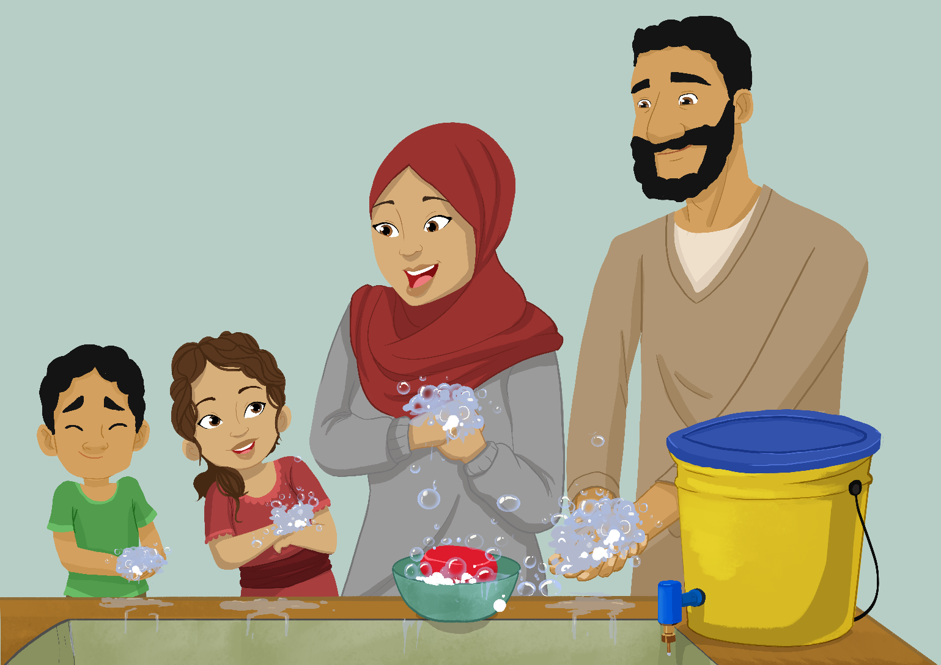
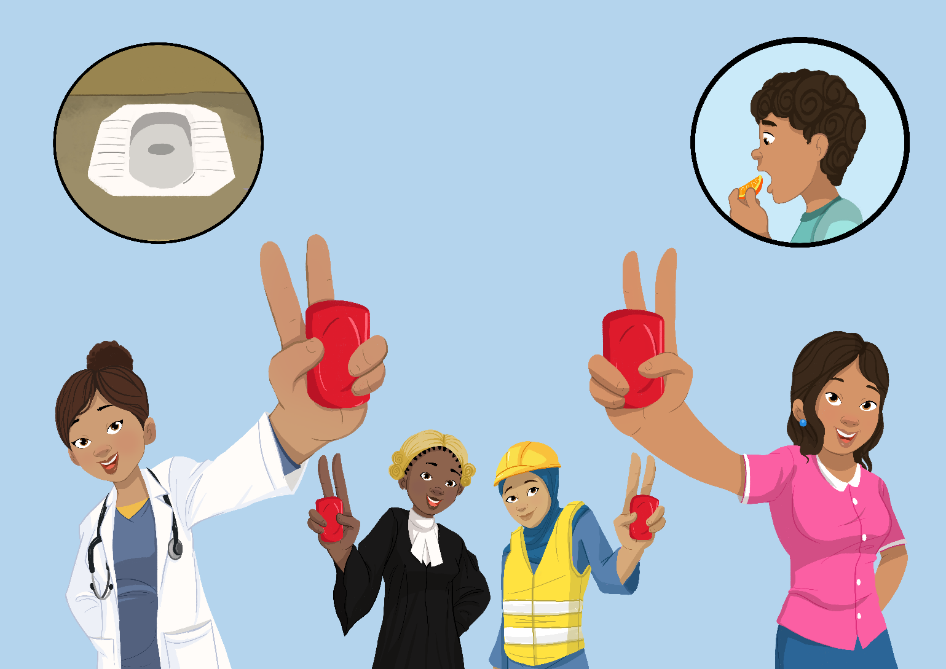
Mum’s Magic Hands - Concept
Mums magic hands is a story that empowers mums living in challenging circumstances to make a difference to their children’s health and future through handwashing with soap
Mum’s magic hands is a story told from the eyes of a little girl in a camp.
Notes:
She talks about her mum’s magic hands which take care of her all day. The same magic hands teach her good habits and particularly how important it is to wash hands with soap after the toilet and before eating because the invisible germs on them will make her sick if she doesn’t. Neighbours admire the healthy and well mannered girl making her and her mother feel proud. Years later, the girl grows up to become a successful doctor, she explains it was her mums magic hands that nurtured her and kept her healthy to make her what she is today .

Slide 15
MMH development
Formative research
Findings reveal nurture and affiliation were common motivators in 3 Asia contexts
Mums Magic Hands further pre-tests
Mums Magic Hands trials in stable contexts
MMH Africa trialed in Nigeria Gwoza and Mubi (2017/18)
MMH Asia creative materials developed in 2015/16
Mums Magic Hands Asia version tested in Zatari camp, Jordan (2016) and Bidibidi camp, Uganda (2016)
MMH was pretested in Nepal and Philippines (2016)
MMH rapid response development and trials
Key findings used to produce Mums Magic Hands Africa (2017) and Mums Magic Hands Global (2017)
MMH Africa trialed camp in Ethiopia - Nguenyyiel (2017)
MMH Global trialed in Uganda Kyaka refugee camp (2018)
MMH Global trial in Nduta camp, Tanzania (2017/18)
MMH Asia trialed in Karachi, Pakistan post flood response (2017)
MMH Adaptation to Covid-19 situation
Adaptation of MMH Global storyboard and resource material to Covid-19 situation (2020)

Slide 16


Questions

Slide 17
Session 3: Overview of programme implementation & storyboard
MMH storyboards versions (Asia, Africa and Global)
Key programme materials & Assets designed
Details: Activities, Materials, Channels
MMH Programme

Slide 18
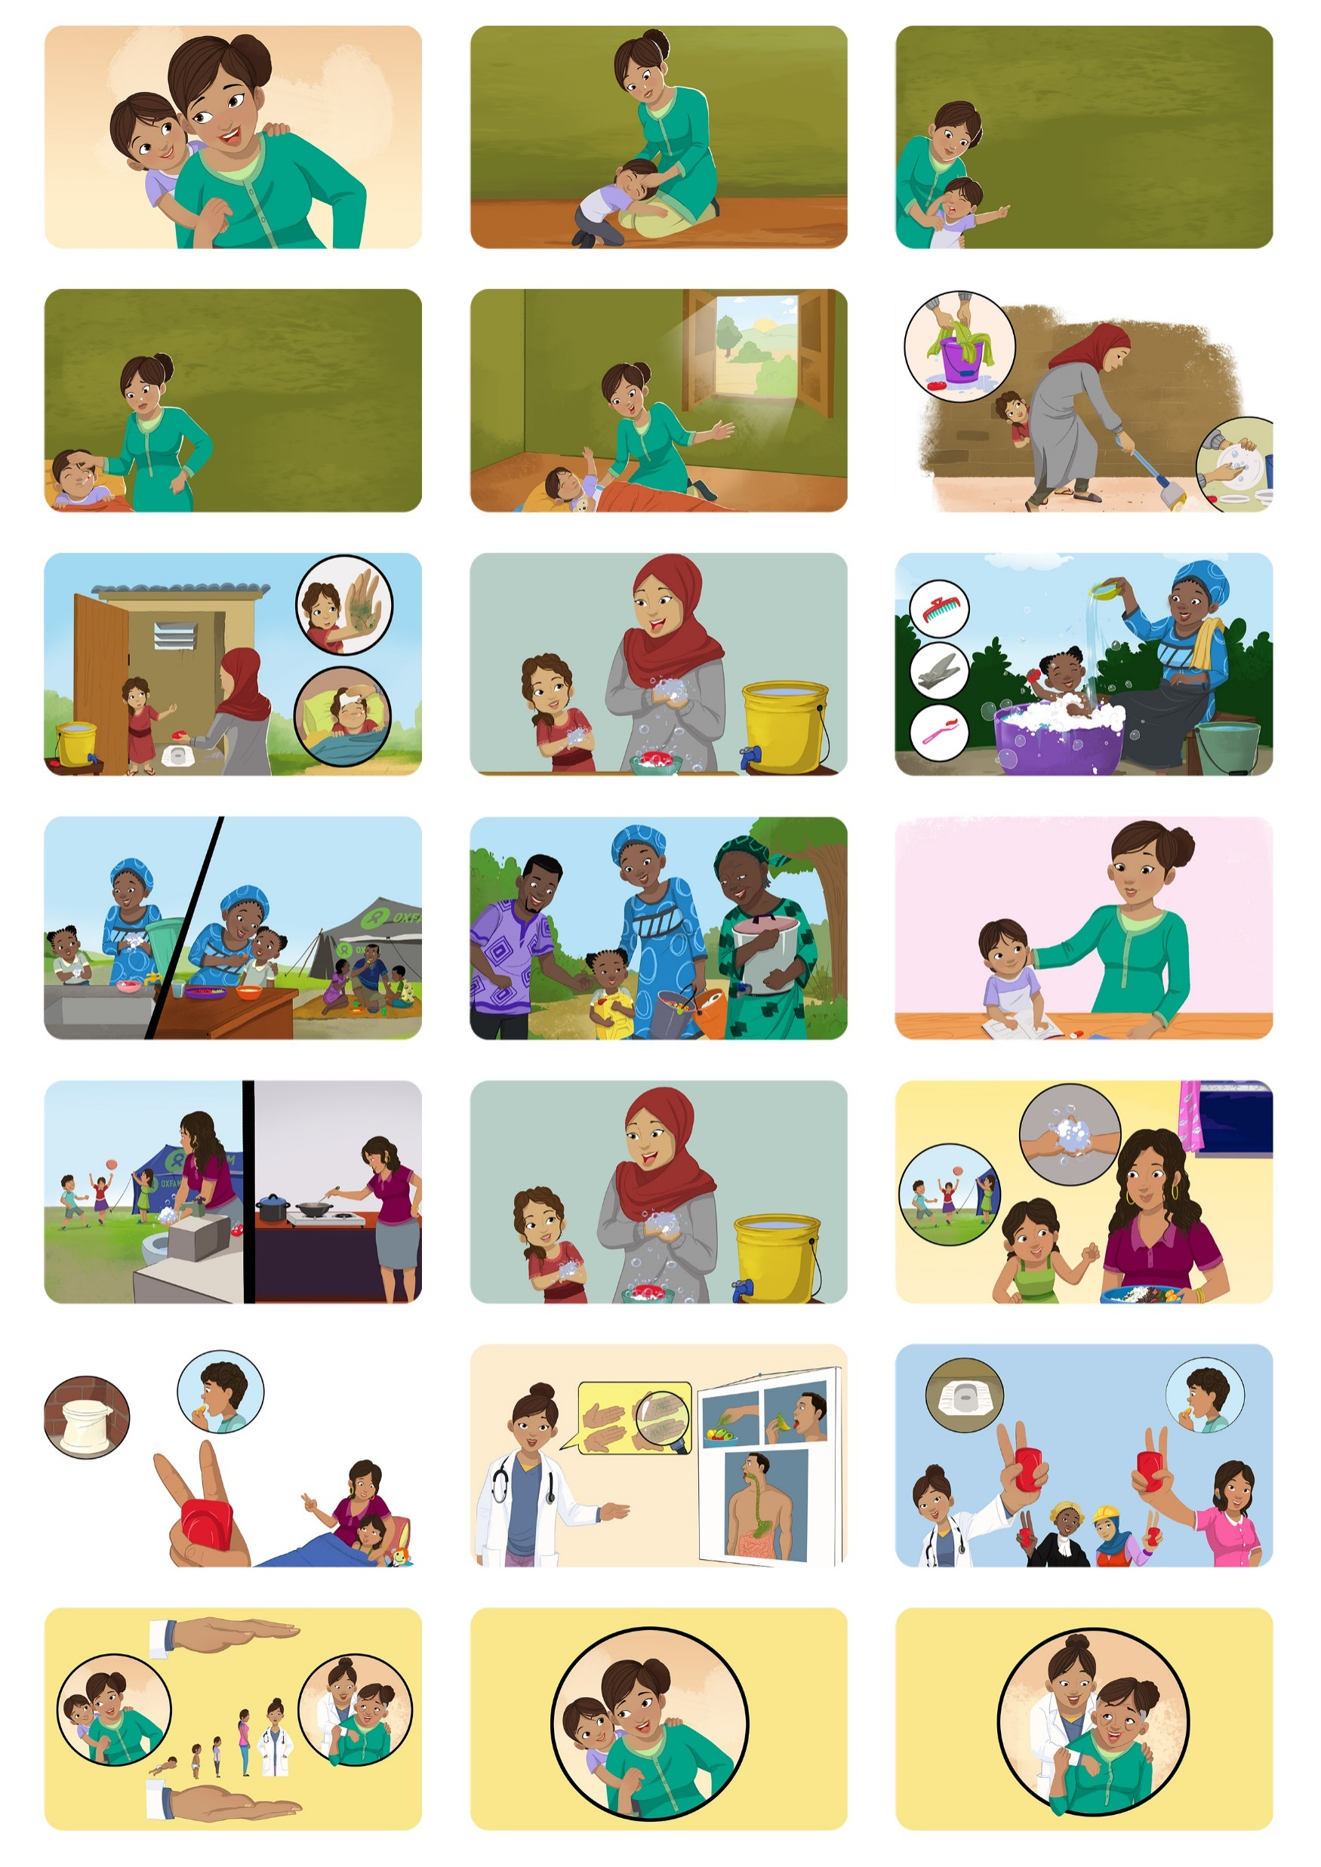
There are different MMH storyboard used in different regions like MMH Asia, MMH Africa and Global one.
As Covid-19 pandemic is all over the world so we are adapting Global Storyboard which is multicultural and can be used in many regions/contexts.
MMH Storyboard (Global Version)

Slide 19
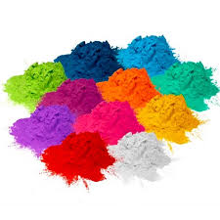
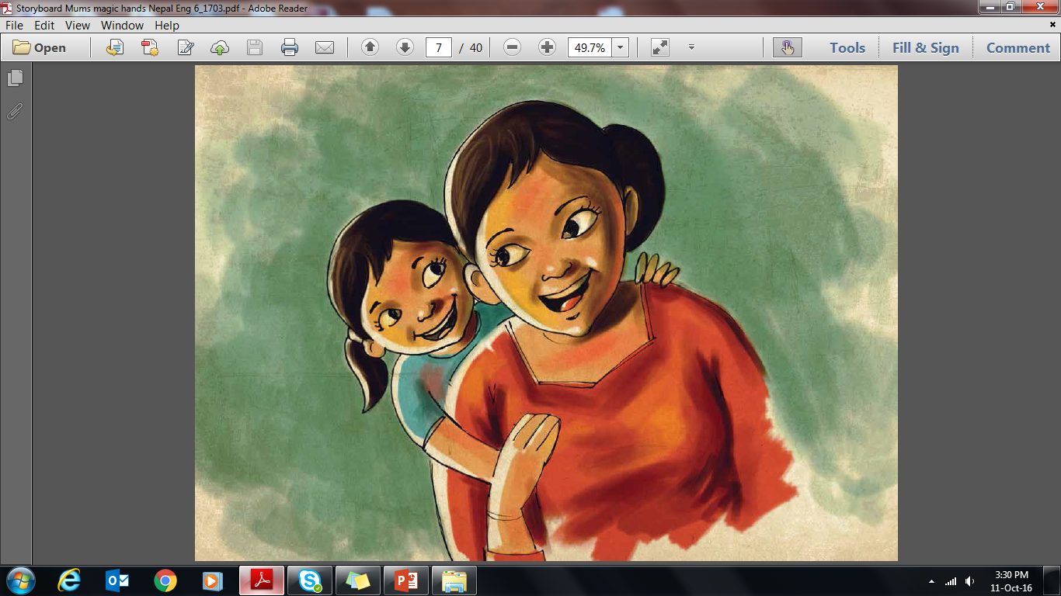
KEY PROGRAMME MATERIALS
A number of materials used in the programme proved popular among the mothers:
Men’s role play
Bedtime tale
a contest among participants to develop HWWS at key occasions bedtime stories for their children
Coloured powder exercises
on mothers’ hands to demonstrate that “visibly clean is not clean” and the importance of using soap to remove invisible germs.
An activity to help men think about how their hands can be magical by demonstrating hygiene practices and care work at household level
Mum’s Magic Hands storyboard
tells the heroic efforts of a mother nurturing her daughter with her magic hands
Scratch cards
removed by a mother every day as a reward to her child for proper HWWS at key occasions practice
Notes:
Mum’s Magic Hands storyboard is used in group sessions to raise awareness. It tells the story of a mother and her heroic efforts to nurture her daughter with her magic hands. Against all odds and despite the difficult conditions of an emergency context, she is able to instill good handwashing habits in her child which leads to her daughter’s ultimate success in life. The story is based on nurture and affiliation.
Coloured powder exercises demonstrating that “visibly clean is not clean” and the importance of using soap to remove invisible germs, by using coloured powder to help the women understand the difference between hands washed with soap and hands washed only with water – this proved to be a strong motivator for change among the target group
Scratch cards serving as a method to self-monitor handwashing practices in the home by rewarding children with a scratch card of a handwashing story beneath the overlay. Mothers remove one scratch card square per day with their child, to be scratched only when proper HWWS is practiced at two key times by both mother and child, ultimately revealing the next part of the story
Circle of cleanliness to reinforce the importance of handwashing with soap through social pressure and establish affiliation and group norm – by using a circle drawn in coloured powder to represent a clean area where mothers could only enter upon washing their hands
Bedtime tale, a contest among participants to develop HWWS bedtime stories for their children, reinforcing the importance of a mother’s role in ensuring children develop good HWWS habits

Slide 20


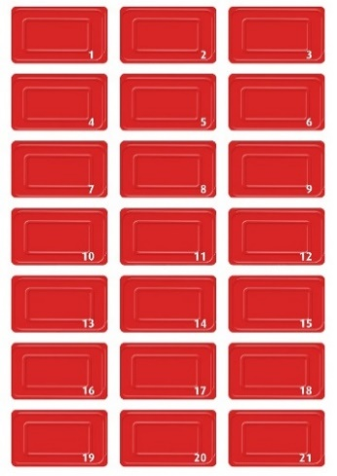
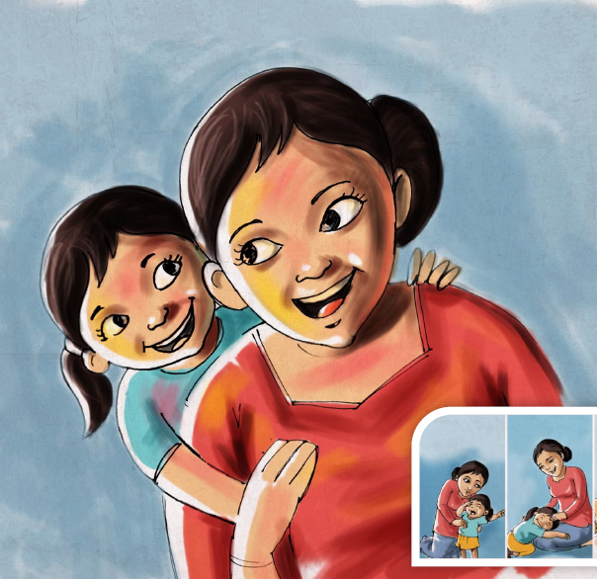
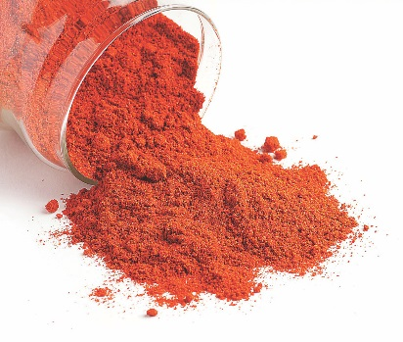


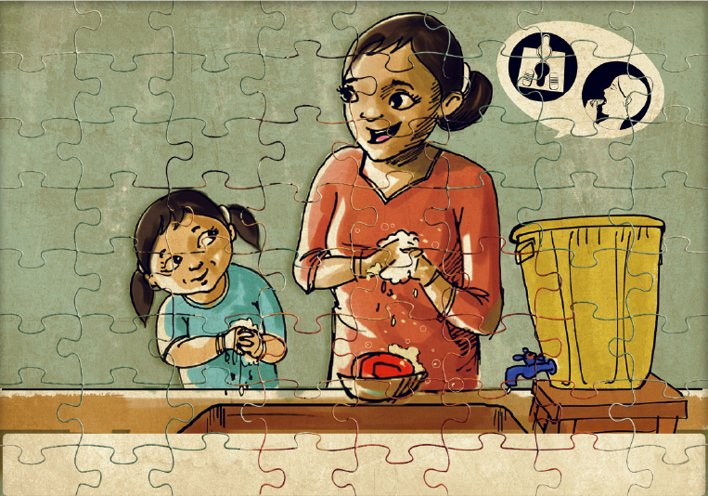
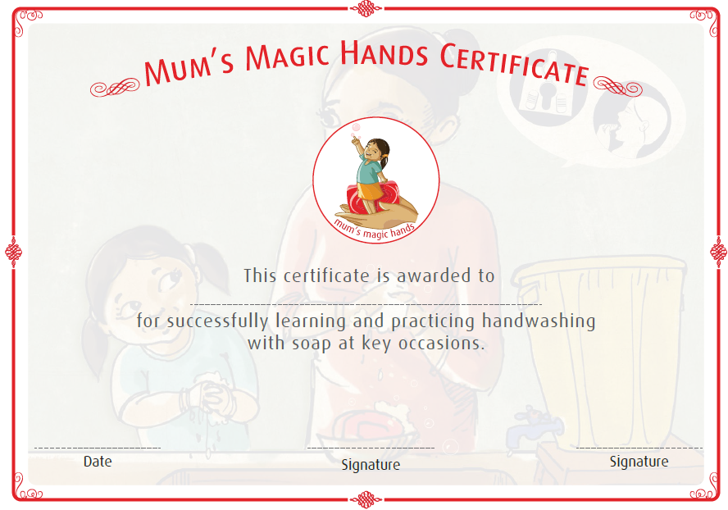
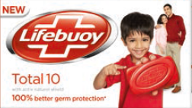
Assets designed for Mum’s Magic Hands
Awareness
Commitment
Mum’s magic hands flipchart
Red powder demo to show water alone is not enough
21-day diary
Scratch card
Reinforcement
Reward
Footstep cooking/
washroom/bucket stickers as reminders
Soap to enable handwashing with soap
Magic hands certificate and handwashing with soap puzzle
to be awarded
to mums upon
completion of
the programme

Slide 21
All Mums Magic Hands Activities, materials and channels
MMH Activities | Materials needed | Communication channels
Awareness
Storyboard | Adapted Global storyboard (Laminated color cards)/video | Face to face, digital technology (WhatsApp, facebook, any video calling)
Reinforcement
Coloured Powder | UV Light, color powder, glo germ powder, perfumed powder, water+Soap, handwashing step poster | Face to face, digital technology (WhatsApp, facebook, any video calling)
Pepper and soap | Pepper, soap, plate and water | Face to face, digital technology (WhatsApp, facebook, any video calling
Covid-19 Transmission routes | Posters of Transmission routes/blockages | Face to face, digital technology (WhatsApp, facebook, any video calling
Magic Hands participatory exercise | 2 Boxes with hole, picture ballots | Face to face, digital technology (change exercise, use voting on WhatsApp, facebook via video call or sharing pictures of ballots etc)
Magic Child exercise | Adapted storyboard | Face to face, digital technology (WhatsApp, facebook, any video calling
Magic Dad exercise | Adapted storyboard | Face to face, digital technology (WhatsApp, facebook, any video calling
Bedtime tale | MMH Storyboard, copies of Frame 13 | Face to face, digital technology (Phone calls, WhatsApp, facebook)
Germs transmission routes/blockages | Posters of transmission routes/blockages | Face to face, digital technology (watsapp, facebook, any video calling)
What goes round | Print of Frame09 behavioral manners
Routine dial | Print of clock, images of handwashing with soap, images of daily routines, markers, white papers
Community meetings | Good airy meeting place | Face to face, using technology to organize community groups and ensure they conduct meetings considering protective measures of Covid-19
Notes:
Mum’s Magic Hands storyboard is used in group sessions to raise awareness. It tells the story of a mother and her heroic efforts to nurture her daughter with her magic hands. Against all odds and despite the difficult conditions of an emergency context, she is able to instill good handwashing habits in her child which leads to her daughter’s ultimate success in life. The story is based on nurture and affiliation.
Coloured powder exercises demonstrating that “visibly clean is not clean” and the importance of using soap to remove invisible germs, by using coloured powder to help the women understand the difference between hands washed with soap and hands washed only with water – this proved to be a strong motivator for change among the target group
iiColoured powder exercise – an exercise using coloured powder and two volunteers to reinforce the idea of invisible germs and HWWS behaviour.
ii. Circle of cleanliness – a circle drawn with coloured powder to represent a pure and clean area whereby one must wash hands with soap before entering.
iii. Magic Hands Participatory exercise – activity reinforces the link between HWWS and the amount of magic in participant’s hands.
iv. Bedtime tale – contest among participants to develop HWWS bedtime stories for their children. Reinforces the importance of ensuring children develop good HWWS habits.
v. What goes around – a set of questions around the affiliation frame of storyboard to reinforce the affiliation driver and its link to HWWS.
vi. Routine dial –reinforces key HWWS key times with mothers and children.

Slide 22
All Mums Magic Hands Activities, materials and channels
MMH Activities | Materials needed | Communication channels
Reminders and silent nudges
Stickers | Printed stickers, 4 for each participant | Need Physical visit to place Stickers (Follow protection measures for Covid-19)
Posters | Printed posters | Need physical visit to paste posters (Follow protection measures for Covid-19)
Nudges – footprint, mirrors etc | Foot prints printed on tiles, concrete etc | Need physical visit to place footsteps (Follow protection measures for Covid-19)
Remember Game
Rewards
Certificates | Colour printed certificates for all participants
Scratch cards | 1 scratch card for each participant
Notes:
Mum’s Magic Hands storyboard is used in group sessions to raise awareness. It tells the story of a mother and her heroic efforts to nurture her daughter with her magic hands. Against all odds and despite the difficult conditions of an emergency context, she is able to instill good handwashing habits in her child which leads to her daughter’s ultimate success in life. The story is based on nurture and affiliation.
Coloured powder exercises demonstrating that “visibly clean is not clean” and the importance of using soap to remove invisible germs, by using coloured powder to help the women understand the difference between hands washed with soap and hands washed only with water – this proved to be a strong motivator for change among the target group
iiColoured powder exercise – an exercise using coloured powder and two volunteers to reinforce the idea of invisible germs and HWWS behaviour.
ii. Circle of cleanliness – a circle drawn with coloured powder to represent a pure and clean area whereby one must wash hands with soap before entering.
iii. Magic Hands Participatory exercise – activity reinforces the link between HWWS and the amount of magic in participant’s hands.
iv. Bedtime tale – contest among participants to develop HWWS bedtime stories for their children. Reinforces the importance of ensuring children develop good HWWS habits.
v. What goes around – a set of questions around the affiliation frame of storyboard to reinforce the affiliation driver and its link to HWWS.
vi. Routine dial –reinforces key HWWS key times with mothers and children.

Slide 23
MMH Programme

Slide 24
Programme targets
Primary targets
Mothers were found to be the most significant hygiene influencers. As caregivers, their behaviour was most likely to have an impact on children under 5.
Grandmothers, aunts and older siblings often also care for children, Mum’s Magic Hands targets women of all ages who care for under 5s.
Secondary targets
It’s much easier to change children’s behaviour. Along with motivating them through their mothers, we have also targeted activities for children.
Fathers can also play a role promoting handwashing habits. We also have activities geared towards men.

Slide 25

Pre-existing conditions
Before implementing the programme, make sure
the environment and situation are suitable.
Some pre-existing conditions include:
Handwashing with soap practice is poor/low
Pre-test the storyboard with a sample of the target population
Basic needs should be met – i.e. shelter, food, water, latrine with handwashing station at communal and household levels, hygiene kits etc.
Notes:
Before implementing the programme, make sure the environment and situation are suitable.
If certain conditions aren’t met, the programme may actually frustrate people, rather than motivate them.

Slide 26
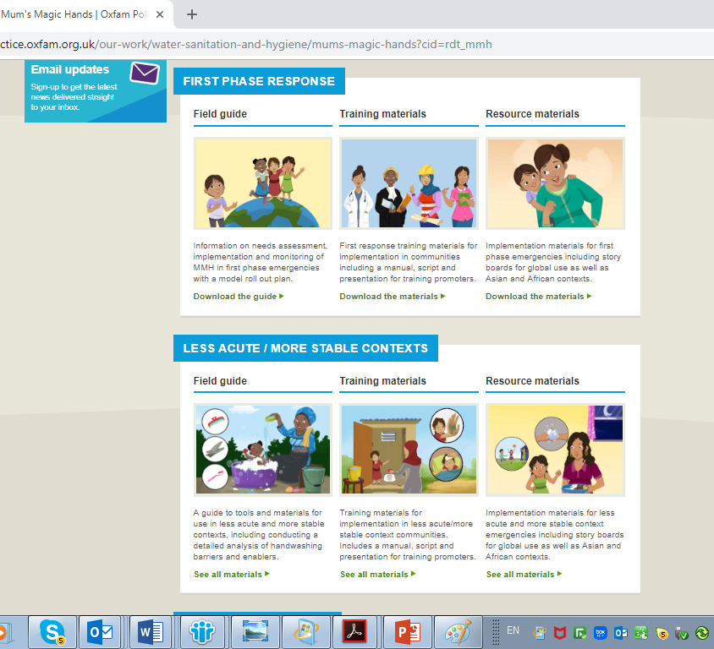
MMH resource material:
Following resource material is available on Oxfam website and box folders. Covid-19 adapted material is already on Box but will upload on website soon.
Field Guide
Training Material (ToT Guide, Promoters Script)
Resource Material (MMH Storyboard, formative research material)
Website Link: www.Oxfam.org.uk/mmh
Box Link: ALL https://oxfam.box.com/s/nvbqi09fs31xxiwa9wne3di3mtr1n1tg
Box Link: Syria
https://oxfam.box.com/s/75vrzkphxbie68rijflxxkph9ant839f

Slide 27
MMH Storyboard
Mum’s Magic Hands storyboard is used in group sessions to raise awareness.
It tells the story of a mother and her heroic efforts to nurture her daughter with her magic hands.
Against all odds and despite the difficult conditions of an emergency context, she is able to instill good handwashing habits in her child which leads to her daughter’s ultimate success in life.
The story is based on nurture and affiliation.

Slide 28
Session 4: MMHs Sessions Flow
  GROUP ACTIVITY -1: MMH Storyboard Pretesting (25 mins)
  Stages/Steps of MMH at a glance (20 mins)
  Stage 1 - Pre-implementation preparation (procurement, training)
  Stage 2 - Implementation of MMH program
  Stage 3 - Monitoring
  Stage 4 – Evaluation
  Promoters key consideration, skills, Adult learning approach (10 mins)
  Group Activity 2: Storyboard (Q&A) & Group Presentation (30 mins)
  Group Activity 3: Activities Practice & Group Presentations (30 mins)

Slide 29
GROUP ACTIVITY-1: MMH Storyboard Pretesting
Time for activity: 20 minutes
Breakout in 2 groups (Separate for male and female)
Task:
Facilitators should go through MMH Storyboard in both men, women groups, ask questions and get feedback.
Group | Men | Women
Activity | MMH Storyboard Pre-test and motivation for Dads Magic Hands | MMH Storyboard Pre-test

Slide 30
Stages/Steps of MMH at a glance
Stage 1 - Pre-implementation preparation (procurement, training)
Step 1.1 | Adaptation of MMH resource material for Covid-19 situation
Step 1.2 | 02 Days MMH Training for Oxfam Partner staff
Step 1.3 | Recruitment of Promoters/Champions
Step 1.4 | Visibility materials for MMH Promoters (Backpack, Tshirt, soap/hand sanitizers, face mask)
Step 1.5 | Translation of materials (Storyboard, promoter scripts, training material)
Step 1.6 | Print MMH materials (Storyboard, Footsteps utensils, posters)+ procurement of material for activities (Glo gem, colour powder, mirrors)
Step 1.7 | 01 Day ToT for Oxfam/partner PHP staff who will further train MMH Promoters/Volunteers/Champions

Slide 31
Stages/Steps of MMH at a glance
Stage 2 - Implementation of MMH program
Step 2.1 | Reminders, reinforcements (install footsteps, mirrors, stickers/posters)
Step 2.2 | Session 1 (10-20 Mother groups)
Step 2.3 | Session 2 (10-20 Mother groups)
Step 2.4 | Session 3 (10-20 Mother groups)
Step 2.5 | Session 4 (10-20 Mother groups)

Slide 32
Stages/Steps of MMH at a glance
Stage 3 - Monitoring
Step 3.1 | Quantitative (Structured observation, mini survey)
Step 3.2 | Qualitative (FGDs)
Stage 4 - Evaluation
Step 4.1 | Endline evaluation (Structured observation, KAP, FGDs)

Slide 33
Stage 1 - Pre-implementation preparation
Step 1.1: Adaptation of MMH Resource Material:
Adaptation for Covid-19 situation is ongoing and will upload on Box and Oxfam website once it will be finalized.
Step 1.2: 2 Days MMH Training with Oxfam/partner staff:
2 days training for Oxfam/Partner staff. If it is online/remote training then add 1 more day particularly for ToT on step by step guide and practicing all activities.
Notes:
MMH Promoters Requirement:

Slide 34
Stage 1 - Pre-implementation preparation
Step 1.3: Recruitment of MMH Promoters:
It is important to remember that the Mum’s Magic Hands (MMH) program will be integrated into the PHP program.
MMH promoters should not be separate from the community health volunteers or public health promotion volunteers that promote hygiene at the community level.
Step 1.4: Visibility materials for MMH Promoters:
Select items that are appropriate to the context and within your budget. Ensure the MMH logo appears on all items (you can also include Oxfam, Lifebuoy & Unilever and partner logos if appropriate).
It could be Backpack, Tshirts and If targeted location is where there are COVID-19 active cases then also include face mask (preferably reusable masks) and soap/hand sanitizer for promoters.
Notes:
MMH Promoters Requirement:

Slide 35
Stage 1 - Pre-implementation preparation
Step 1.5: Translation of Materials:
At this stage MMH Storyboard, Promoter scripts and Training material should be translated into local language.
Don’t forget to pre-test the translation before printing!
Step 1.6: Printing and Procurement of Mum’s Magic Hands Material:
Print material like storyboard, posters, stickers, scratch cards and footsteps. Size of the printing material should be of your choice depending on context/availability ensuring printing material should be clear, readable and of good quality.
Procure material for activities like Glo germ or coloured powder, coloured chalk or perfumed powder as an alternative, mirrors etc.
Work with your logistics team to identify a supplier that can produce high quality materials in a short timeframe.

Slide 36
Stage 1 - Pre-implementation preparation
Step 1.7: Training of Trainers (ToT):
Once materials have been printed, you are ready for training. Organize 1 day ToT for Oxfam/partner PHP staff who will further train MMH Champions.
Essentially you will take them through the same training they will be implementing with the promoters.
Smaller groups are better (15-20) as it will give promoters an opportunity to practice and role-play the activities
If you are conducting online/remote training because of Covid-19 situation, try to make it as interactive and participative as you can. Spend 10-15 minutes explaining Zoom/Team features with participants to make training interactive and participatory

Slide 37
Stages/Steps of MMH at a glance
Stage 2 - Implementation of MMH program
2.1 | Reminders, reinforcements (install footsteps, mirrors, stickers/posters)
2.2 | Session 1 (10-20 Mother groups)
2.3 | Session 2 (10-20 Mother groups)
2.4 | Session 3 (10-20 Mother groups)
2.5 | Session 4 (10-20 Mother groups)
2.6 | Session 5 - 12 (10-20 Mother groups)

Slide 38
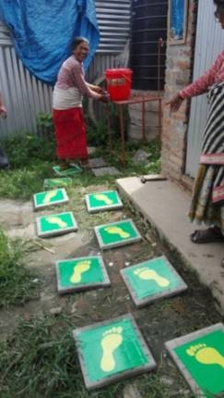
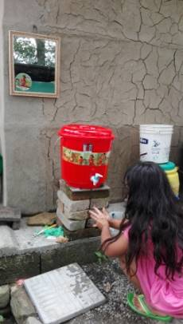
Stage 2 - Implementation of MMH Program
Step 2.1: Reminders/Reinforcement (Silent Nudges):
Initially posters will generate interest and curiosity among the community and later they will serve as reminders.
Silent nudges at communal latrine/HW facilities (footsteps, mirrors + sticker) can be put in place as soon as infrastructure (latrines/handwashing facilities) is complete.
Silent nudges are exactly that – silent! There is no need to explain their purpose to the community.
Don’t forget to adopt posters for Covid-19 and set up few days before beginning the MMH program
Foot Nudges
Mirror

Slide 39
Stage 2 - Implementation of MMH Program
Session 1 | Session 2 | Session 3 | Sessions 4-11 | Session 12/Ongoing interventions
Introduction & HW Assessment (Mini FGD, Voting exercise) | Ice Breaker/Circle of cleanliness | Ice Breaker/Circle of cleanliness | Plan to meet regularly, revise action plans | Recap different sessions and action plans
MMH Storyboard Raise awareness | Recap Session 1 | Recap Session 2 | Take a new topic if required | Certificate award
Glo germ or alternative Reinforce | Voting exercise/ Monitor | Voting exercise/Monitor | Formulate action plans on new topic | Endline evaluation
Stickers Reminders | MMH Storyboard refresher Raise awareness | MMH Storyboard refresher and COVID-19 transmission route | Organise meetings men, children etc
Posters Reminders | MMH Participatory exercise Reinforce | 5 key times Reinforce | Use different activities
Scratch card* Monitor | Bedtime tale Follow up | Routine dial Reinforce (mothers and children)
Bedtime tale contest Reinforce | Introduce another key PH message (i.e. COVID 19 prevention) | Introduce another PH risk key message (i.e. safe faecal disposal)
HW Action plans (on handwashing) | Covid-19 Transmission routes/Blockages | Action plan formulation on safe faecal disposal and or introducing role play activity for men
 | Action plan formulation for COVID 19 prevention and assignment for HW

Slide 40
Recruitment of champions
Step 1.3: Recruitment of MMH Promoters:
Sample for a population of 4,000 families: Once rapid hand washing assessments are completed and the decision made to implement MMH, meet with community representatives to discuss the selection of hand washing champions.
Organize a meeting with the champions to check that they have the necessary skills (refer to their terms of reference in the training guide) and agree volunteer terms and conditions. Below is an example of an implementation for 4,000 families.
Divide the area inhabited by 4,000 families into 20 geographical clusters (or use target area/clusters/zone if they already exist); i.e. 200 families per cluster. Recruit 20 handwashing champions (1 volunteer champion for 200 families and 2 hygiene promotion assistants (HPA) (1 per 10 champions) to manage them.

Slide 41
Key skills required for promoters and champions???
Notes:
This can be interactive exercise
Expected answers can be , participation, demonstrations, cultural sensitivity, understanding how adult learn etc

Slide 42
Key skills required for promoters and champions
Some prior knowledge of health, hygiene, teaching, or community development.
Strong communication skills.
Good listening skills.
Sensitivity to the needs and priorities of different sectors of the community.
Trust and wide acceptance by the community.
Participation, demonstration
Cultural sensitivity
Literacy, numeracy, and record keeping skills are desirable but may not be essential.
Notes:
This can be interactive exercise
Expected answers can be , participation, demonstrations, cultural sensitivity, understanding how adult learn etc

Slide 43
Key considerations for training promoters and champions
What do you think should be the Key considerations for promoters/champions training…???
Notes:
This can be interactive exercise
Expected answers can be , participation, demonstrations, cultural sensitivity, understanding how adult learn etc

Slide 44
Key considerations for training promoters
Ensure participation
Use demonstrations
Be cultural sensitive
Use adult learning methods
Outline, engage, repeat, recap etc
Find out what they know and build on it
Notes:
This can be interactive exercise
Expected answers can be , participation, demonstrations, cultural sensitivity, understanding how adult learn etc

Slide 45
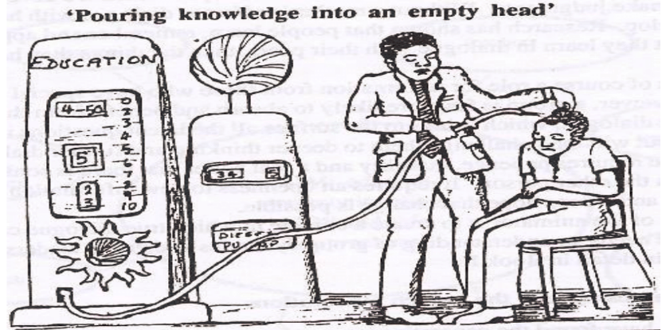
Training approach to education

Slide 46
20%, 40%, 80%
Adults retain:
20% of what they hear
40% of what they both hear and see
80% of what they do or discover

Slide 47
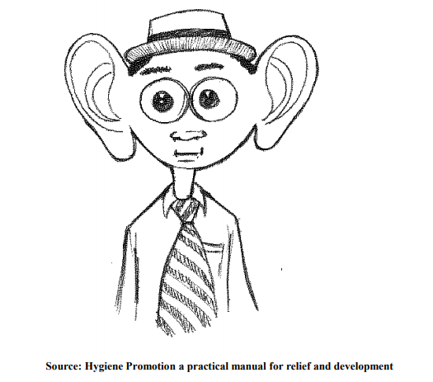
Observation and listening
Big Ears to listen, Big Eyes to See and a Small Mouth to Speak
- Maclean Sosono

Slide 48
Key considerations for training promoters
Once materials have been printed, you are ready for training. Translate resource material before training.
Take them through the same training they will be implementing with the promoters.
Give them all information step by step and explain activities that are done in parallel
Smaller groups are better (15-20) as it will give promoters an opportunity to practice and role-play the activities
If you are conducting online/remote training because of Covid-19 situation, try to make it as interactive and participative as you can.
Spend 10-15 minutes explaining Zoom/Online features with participants to make training interactive and participatory
Notes:
This can be interactive exercise
Expected answers can be , participation, demonstrations, cultural sensitivity, understanding how adult learn etc

Slide 49
GROUP ACTIVITY: 2 MMH Storyboard
Time for activity: 25 minutes
Time for presentation: 5-10 minutes to each group
Breakout in 3 groups
Task Details:
Each group should go through MMH storyboard
Select one facilitator from your group participants
Rest of the participants will play as mothers.
Facilitator will ask questions from mothers using promoters script
Mothers should responds all questions
In the plenary, each group facilitator will give feedback on how he/she felt about questions. Those who role played mothers will also share their thoughts.

Slide 50
GROUP ACTIVITY: 3 Activities Role Play
Time for activity: 30 minutes
Time for presentation: 5-10 minutes to each group
Breakout in 3 groups
Task:
Each group is assigned one activity.
Select facilitator from each group to take lead
Go through promoters script and leader should ensure everyone play their role as per promoter script.
On return from groups all facilitators/other participants will give their feedback about learning from group tasks.
Group | A | B | C
Activity | Colour Powder Demonstration of Visibly clean is not always clean | Draft: Covid-19 Transmission routes/Blockages | Bed time tale (Story on Covid-19 or Hygiene) – compose and read it in a child voice.

Slide 51
Sessions 1: Role play
Assessments
Awareness raising using storyboard
Demonstrations using coloured powder
Distributions, Action plans and tasks e.g. bedtime tales

Slide 52
Stage 3 - Monitoring
Monitoring is an important component of Mums Magic Hands to analyze the impact of the approach. Different activities for monitoring and evaluation are designed for MMH approach.
Quantitative (Structured observations, Mini survey)
Qualitative (FGDs)
Monitoring activity with boxes and ballots for hands with magic and hands with non magic.
Main indicators
Percentage of people washing hands with soap and water the 4 key occasions (there’s sample monitoring forms – Observation guide, FGD guide)
Percentage participants compliance to action plans developed during each session of the MMH programme (there is sample action plan template)

Slide 53
Stage 4 - Evaluation
Baseline and endline evaluation (Structured observations, KAP, FGDs)

Slide 54
Step-by-step IMPLEMENTATION guide
In the Field Guide there’s a step-by-step guide to rolling out the programme for rapid response/acute and less acute/stable contexts
A sample programme plan with a week-by-week timeline is also available.
Pre – implementation activities i.e. Pretest, translation of materials, training of champions etc.
Weeks 1-2
Rapid assessment (ensuring good community entry, consultation and representation) and life saving interventions.
Hardware intervention – stands with hand washing stations, latrines, etc.
Implementation
Weeks 3-36 (can be shorter/longer depending on context)
Hygiene Promotion (including implementation of Mums Magic Hands).
Soap and visual activation ideas material distribution, awareness raising using the MMH storyboard and reminders through group sessions and activities when there is no lockdown

Slide 55
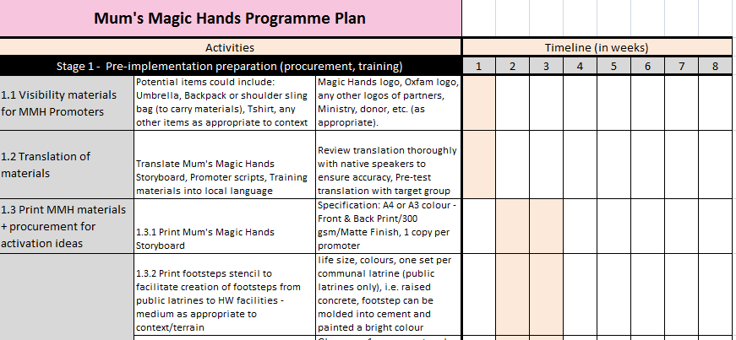

Slide 56

General Instructions for conducting Training during COVID-19:
In COVID-19 situation face to face training is not possible in some contexts because of lockdowns and restrictions imposed by Government. Conduct training remotely using Zoom/Teams or skype in case of lockdown or if teams are working from home.
Not all activities will be possible to do in case of online/remote training. Use maximum features available on Zoom/Team and skype to make training as much interactive and participatory as you can.

Slide 57
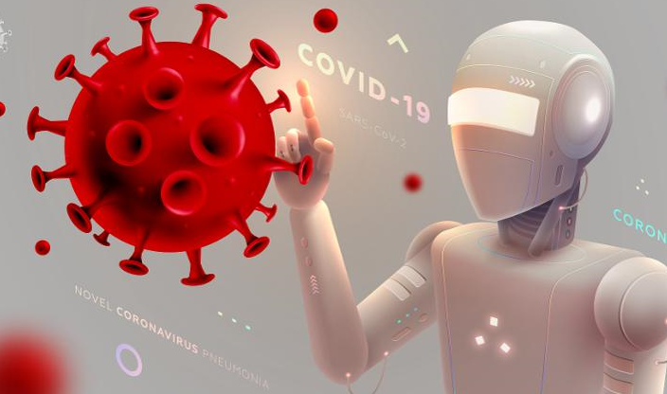




General Instructions for conducting Training during COVID-19:
If there is same situation in communities, use technology (WhatsApp, Facebook, calls, text, radio phones) or other communication channels preferred by community. All mentioned preventive measures for face to face training will be applicable for community sessions as well if implementing MMH in COVID-19 active cases locations.
If situation allows face to face training with promoters then consider all safety/preventive measures recommended for COVID-19 situation.

Slide 58




General Instructions for conducting Training during COVID-19:
Ensure all participants wash their hands with soap for 20 seconds before entering training venue. Also make sure that hand sanitizers are available for the participants to be used during training session.
Keep social distance of at least 2 meters between all participants and make sure that everyone use face mask.
Explain to all participants that if someone sneeze or cough, use tissue and dispose off in dustbin or use your elbow and wash hands either with soap and water for 20 seconds or use hand sanitizer.

Slide 59
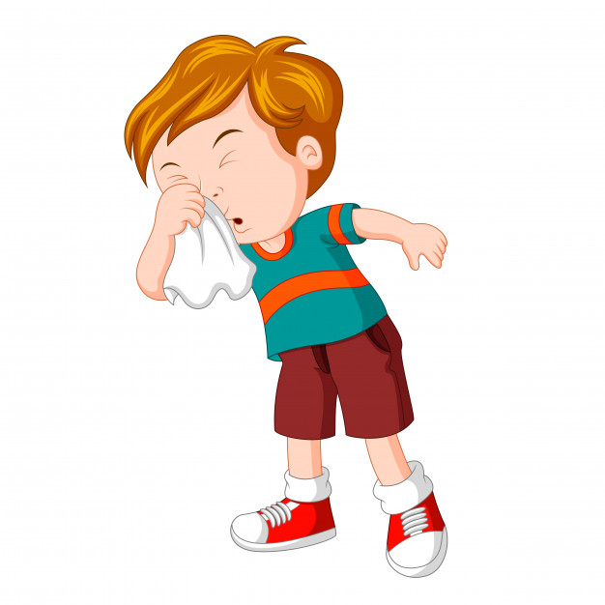
General Instructions for conducting Training during COVID-19:
Ask participants to not attend training if someone feel sick.
Note: For detailed guideline regarding protection of community facing staff from Covid-19 please follow link given below. It also include consent form to be signed by staff/volunteers or MMH promoters.
Guideline: https://oxfam.box.com/s/sous3kcrmtwtmtdbk9ex7yxcdn3bt6kt
Consent form: https://oxfam.box.com/s/5697rthule1e558k4ti5h95sm68edmzi

Slide 60
Questions

Slide 61

Feedback

Slide 62


